Slide 1
Adam Thompson
Director of Sales
adam.thompson@strategycorps.com
615-519-7907
linkedin.com/in/athompson3233
Notes:
Introductions:
create some small talk to establish a good vibe for the interaction
I appreciate you taking this time to visit with me today, and I’m excited to show you some of the things that we do for our bank clients
Why don’t we start with some brief introductions?
I’ll start us off. I’m Dave DeFazio, and I’ve been with StrategyCorps since we started…
(be brief and focus on experiences that are relevant to retail banking and products)
Can you introduce yourself and tell me how you landed in your chair there at the bank?

Slide 2
Deposit Growth:
How to Outmaneuver the Land of Giants

Slide 3
The Deposit Surge is Over…

Slide 4
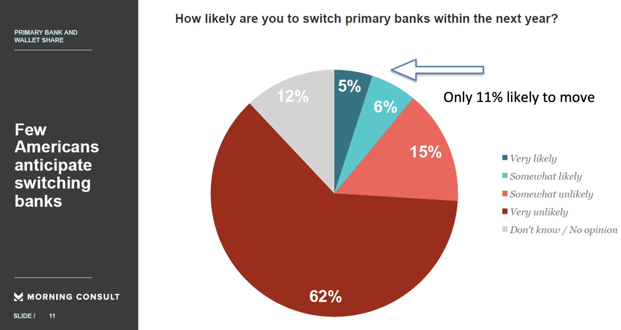

Slide 7
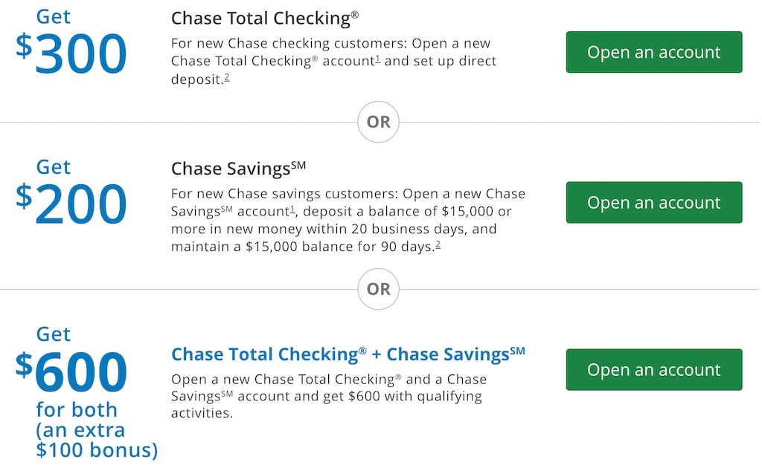

Slide 8
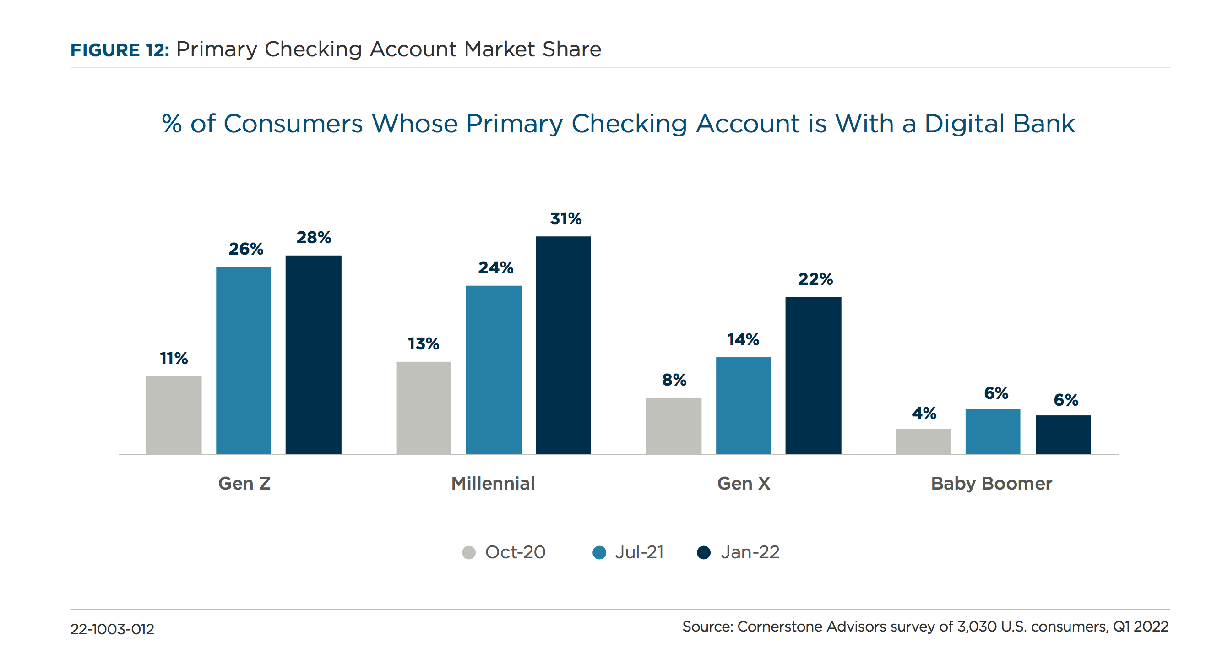
Notes:
And then Whamo! Fast forward to today - look at the dark blue bar. Pre-pandemic it was 4%. Now, only a couple of years later - 22% of Gen X. 31% of Gen Y. 28% of Gen Z name a digital bank as their primary bank.

Slide 9
… always a chance for the underdog!!

Slide 10
Stand out from the crowd…

Slide 11
The Lord of the Ring

Slide 14
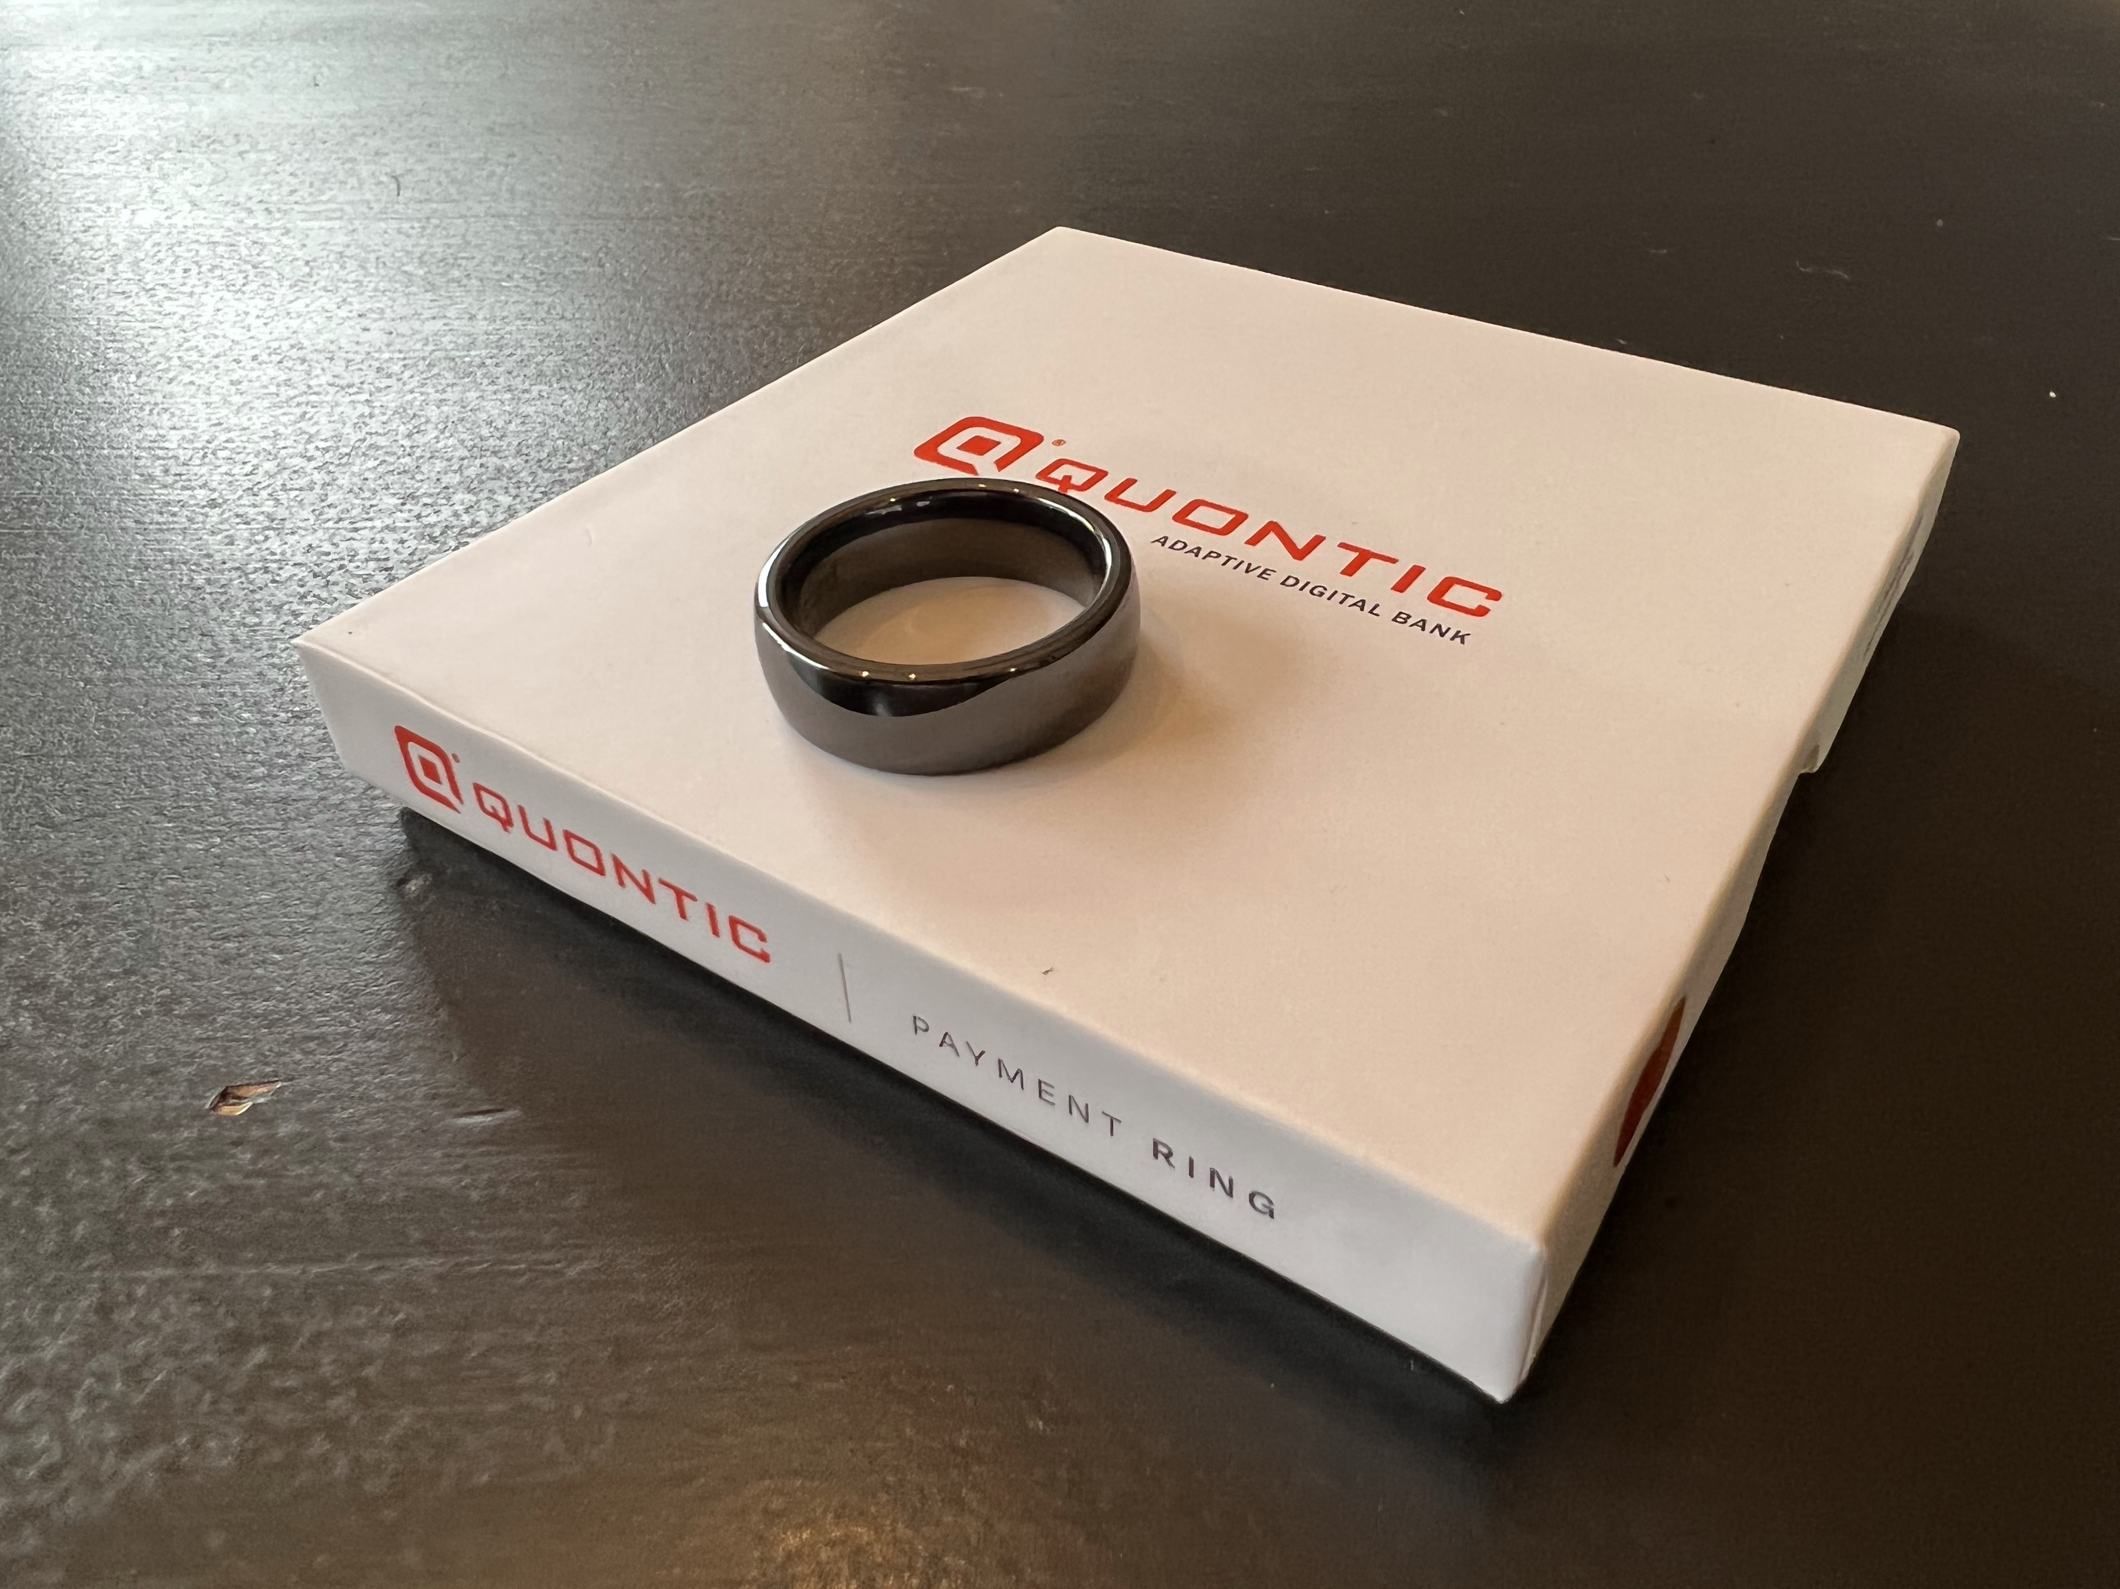

Slide 16
6 merchants

Slide 17
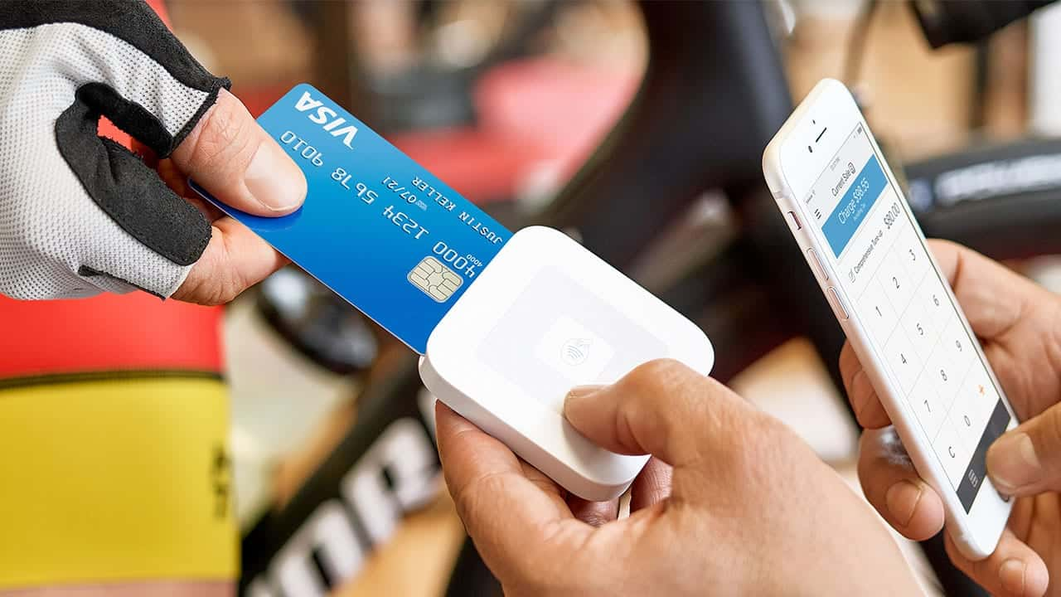

Slide 18
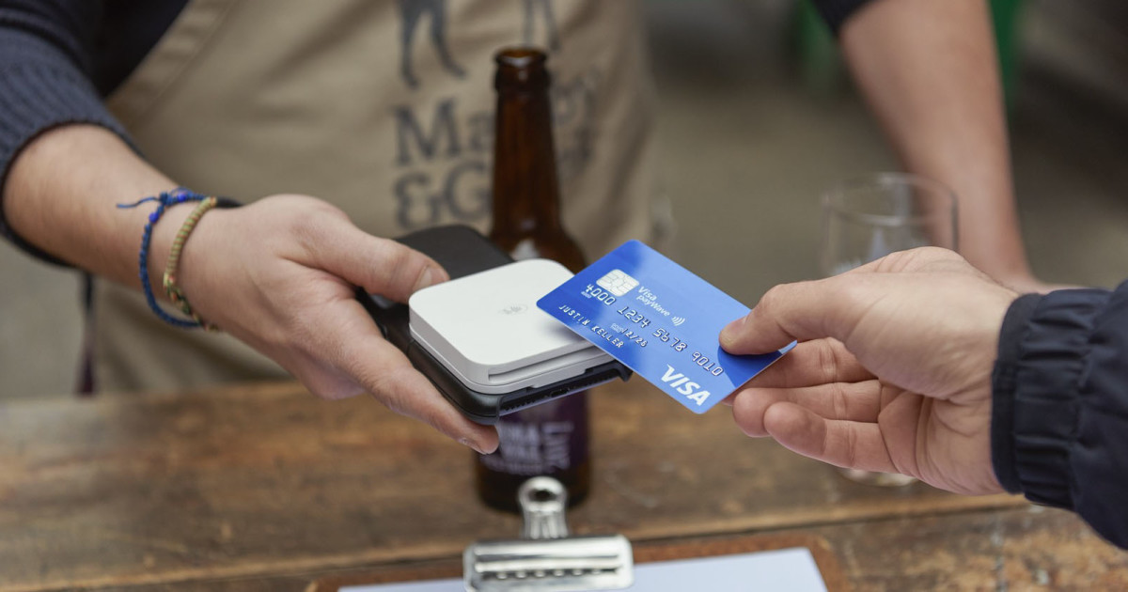

Slide 19
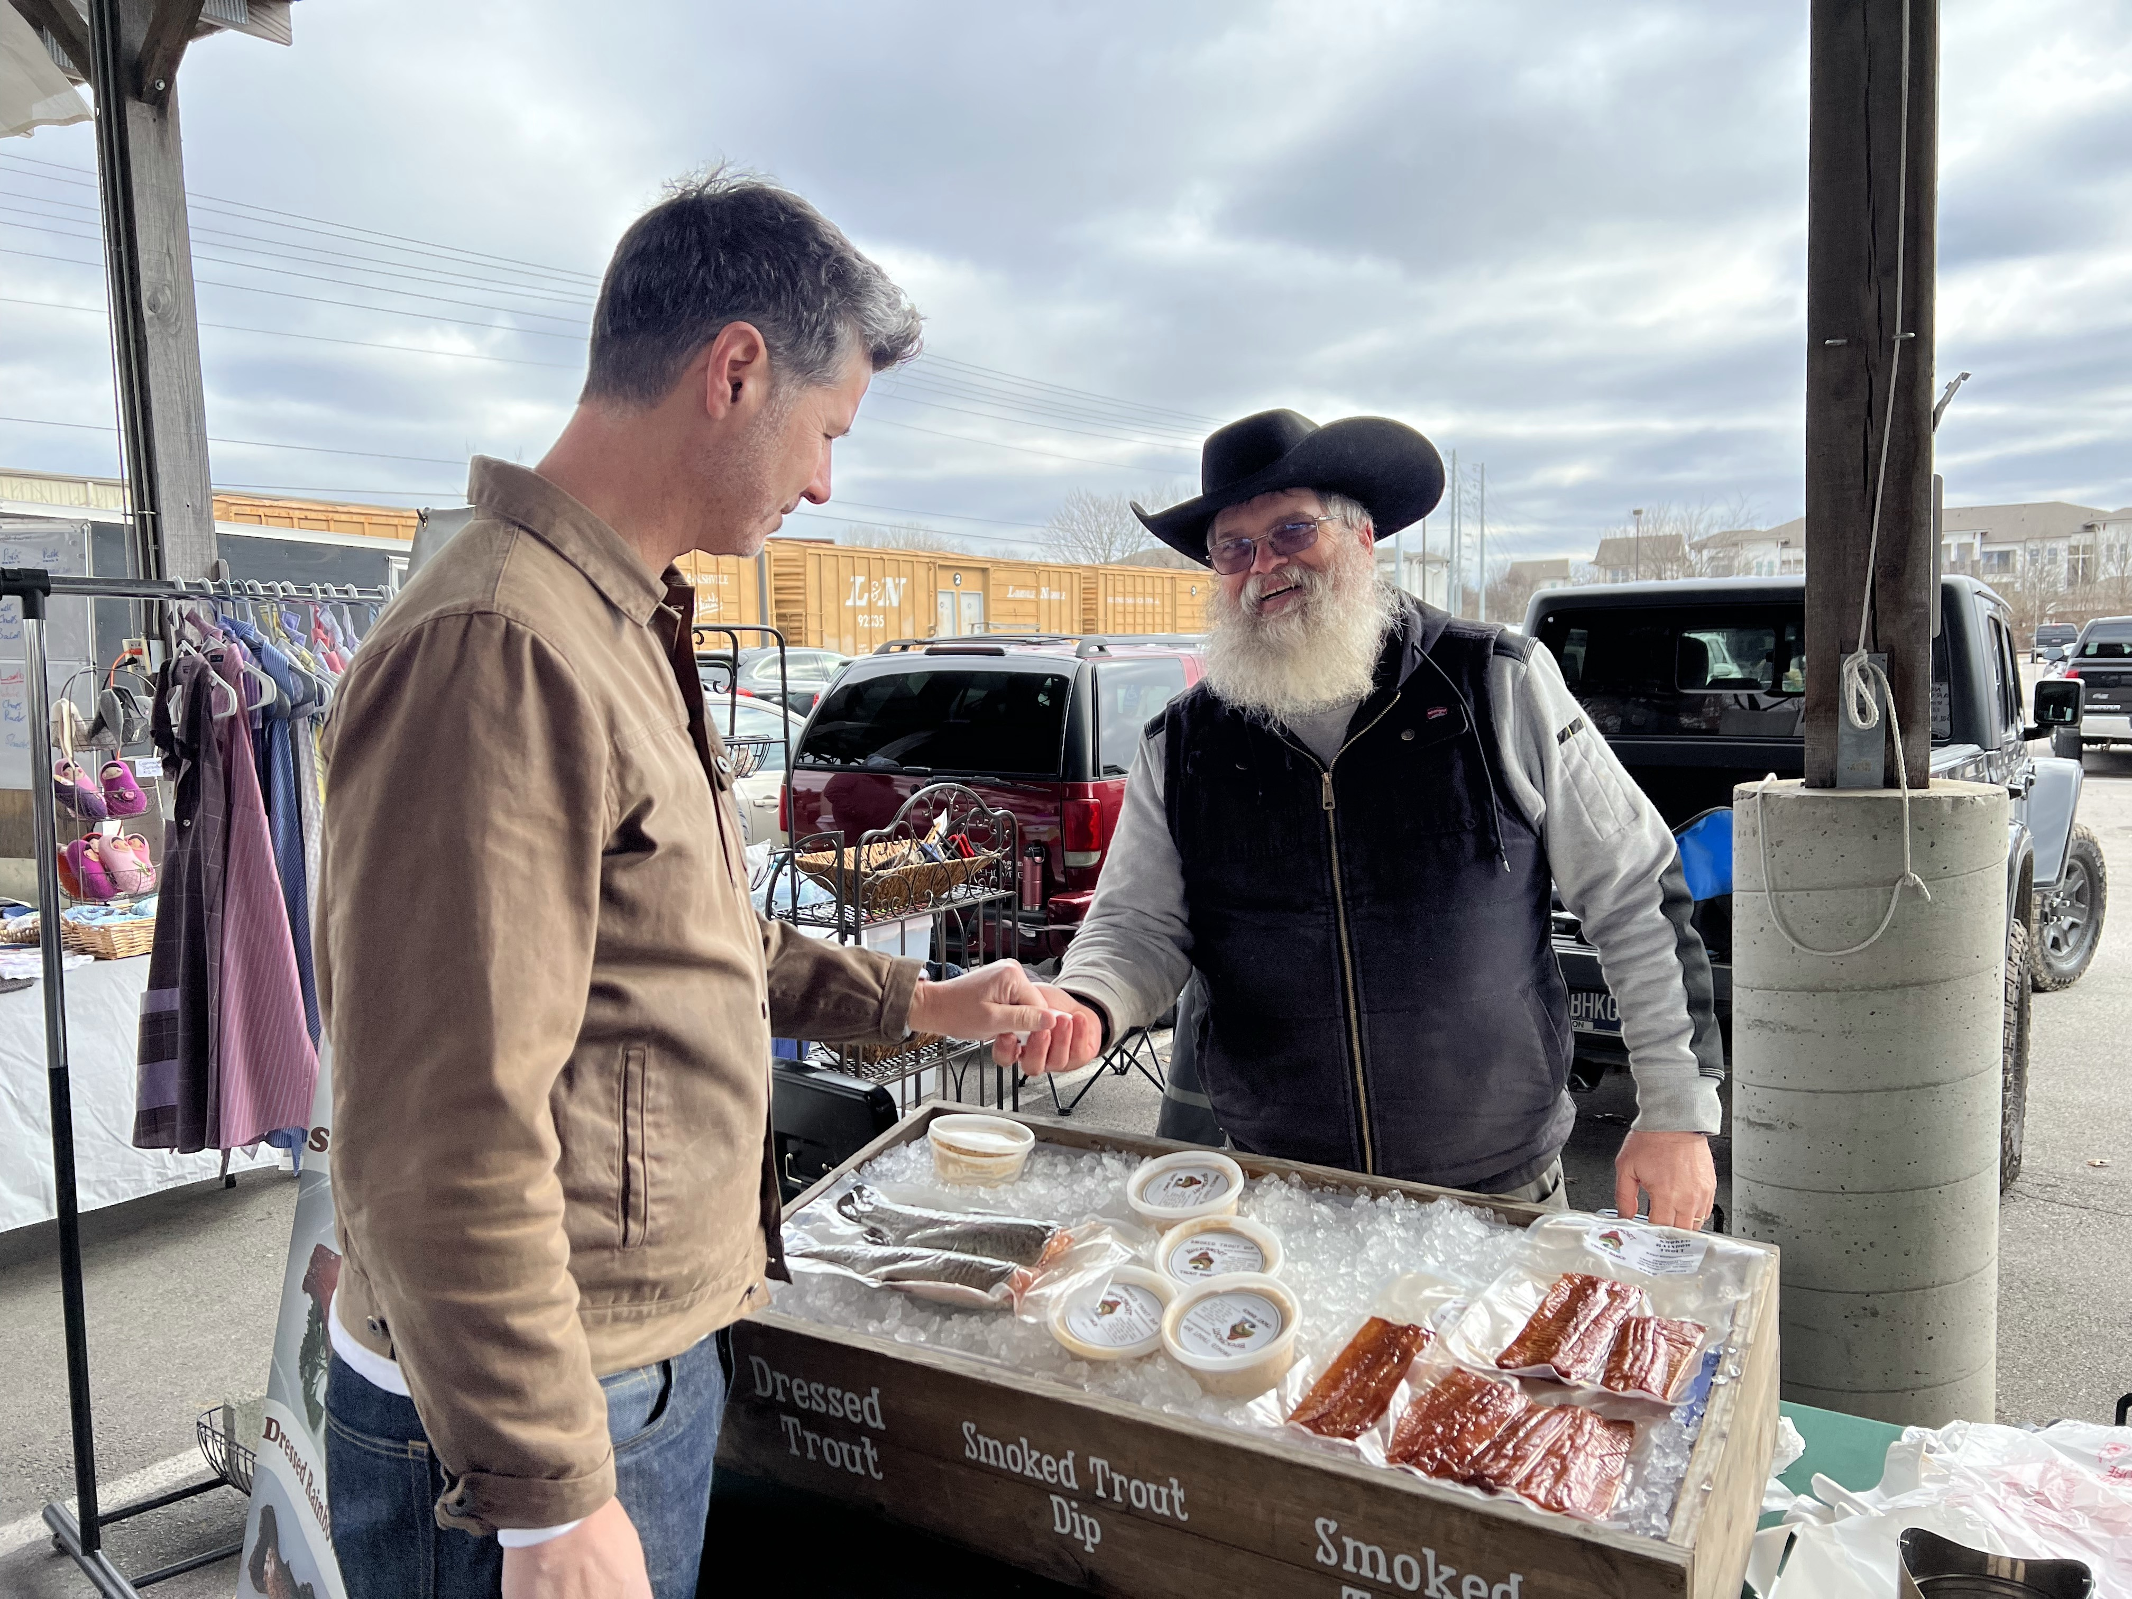
Jim Anderson

Slide 20
Jim Anderson
‘’What was that?”

Slide 21
Jim Anderson
‘’What was that?”
“I’ve never seen that before!”

Slide 22
Jim Anderson
‘’What was that?”
“I’ve never seen that before!”

Slide 23
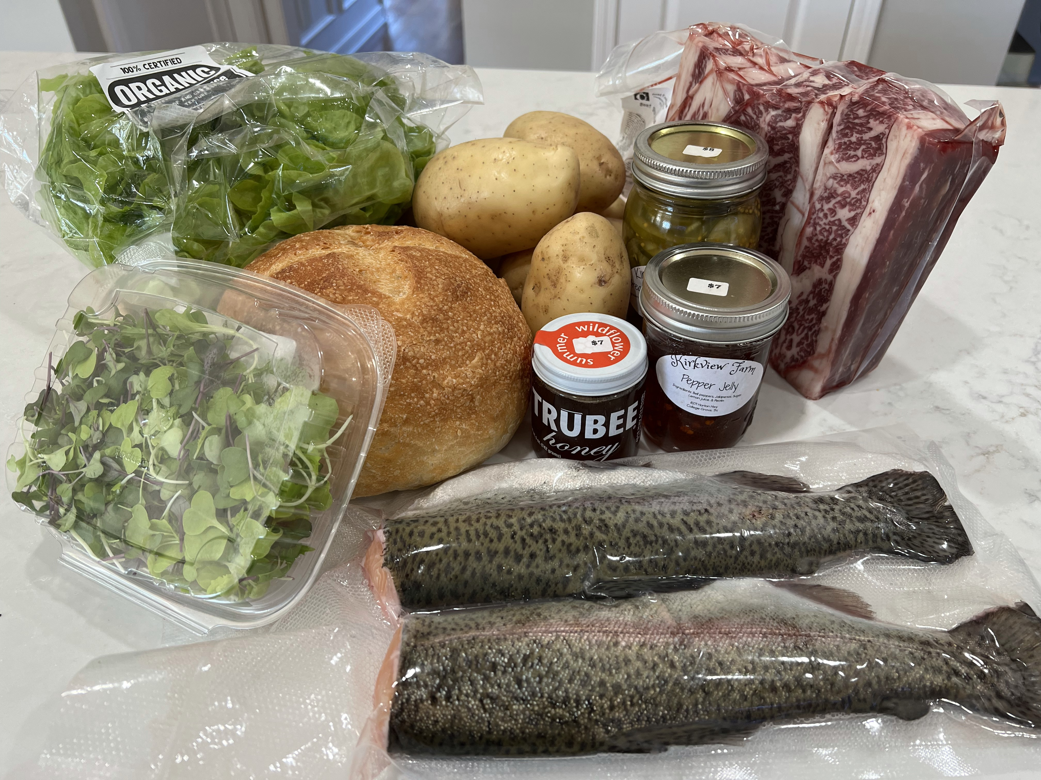
One ring to buy them all

Slide 24
Good deeds can pay-off …

Slide 26
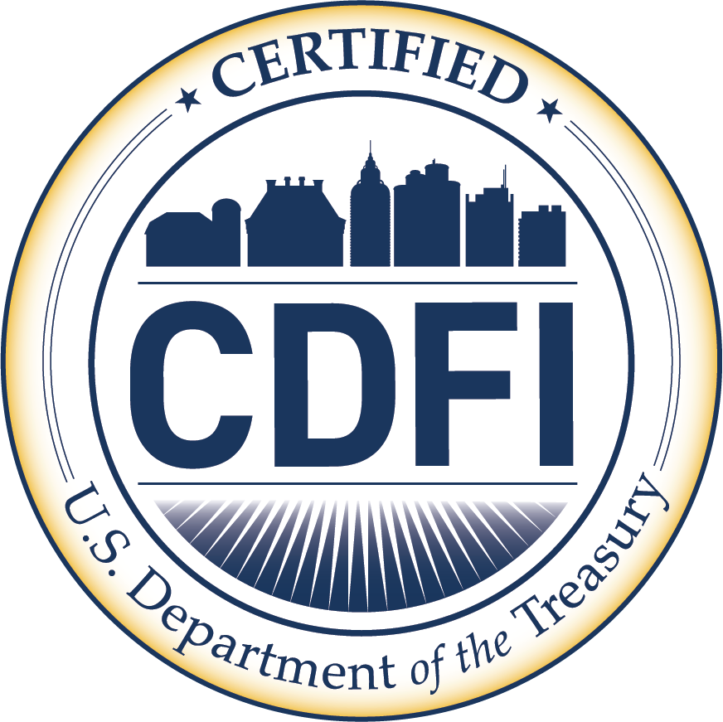

Slide 27
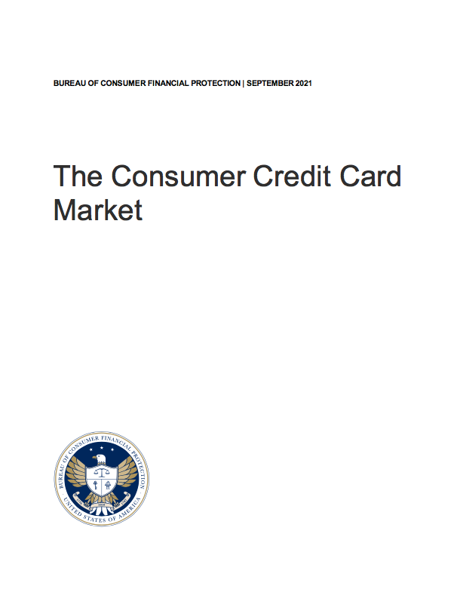

Slide 28
Credit Score Tiers | Score | US Adult Population
Superprime | 720+ | 41%
Prime | 660-719 | 12%
Near-prime | 620-659 | 6%
Subprime | 580-619 | 5%
Deep Subprime | less than 579 | 12%
Thin or stale score file |  | 12%
Credit Invisible |  | 11%

Slide 29
28 million credit invisible
+
21 million unscorable credit
Source: https://www.moneygeek.com/credit-cards/analysis/credit-invisibility/

Slide 30
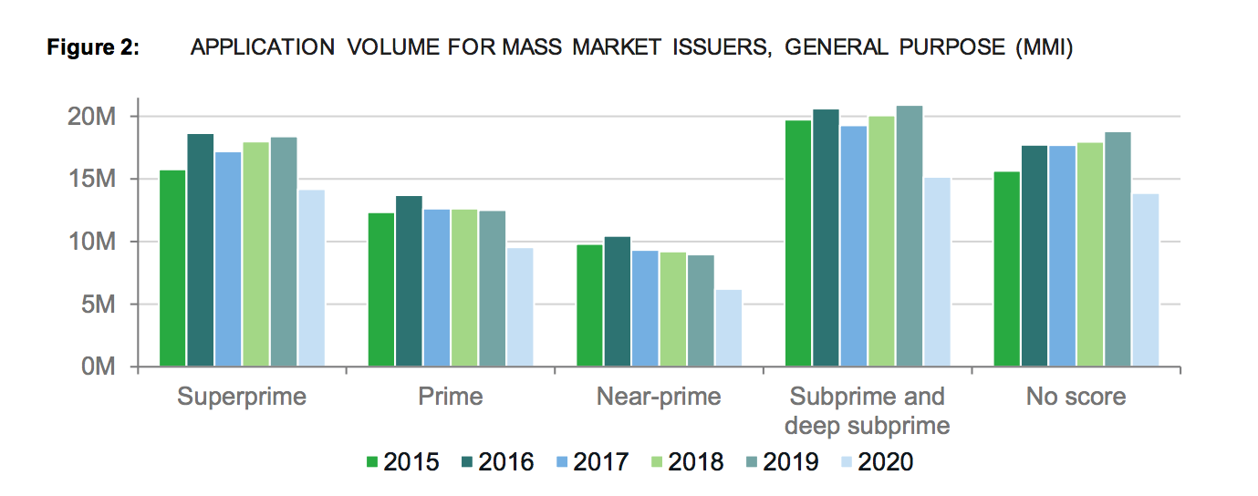

Slide 32
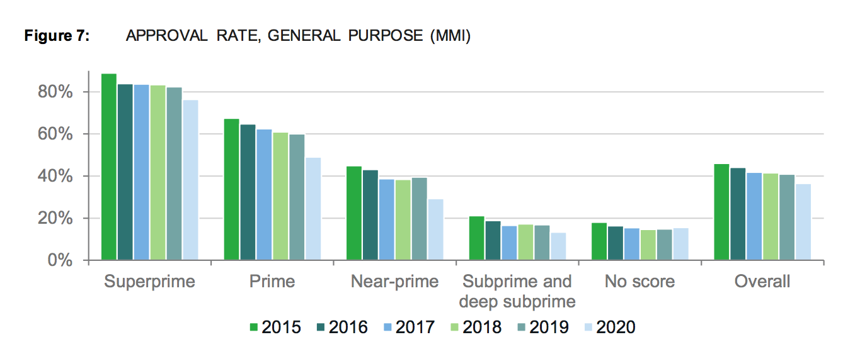

Slide 34
Secured Credit Card Innovation

Slide 35
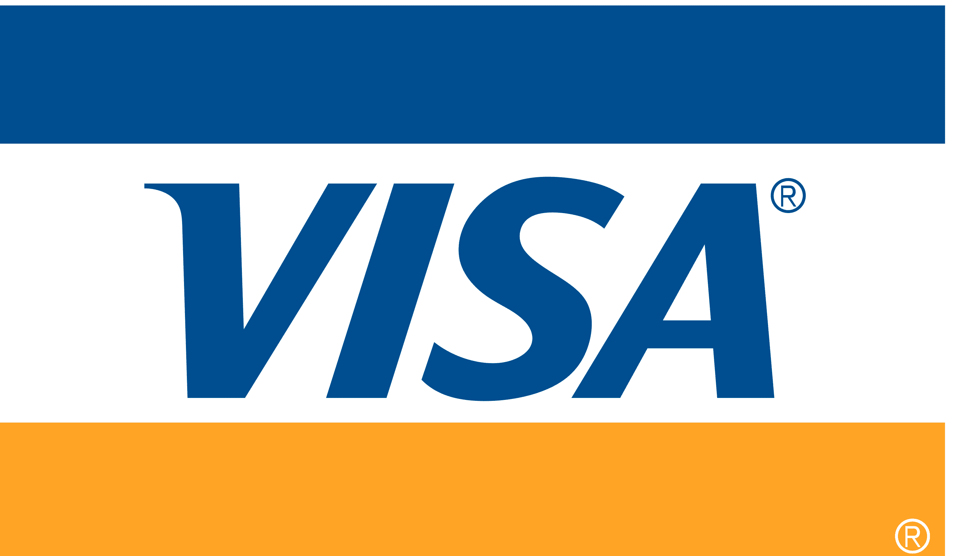
On average, they increase their credit scores by 24 points
Source: Jorge Esteban, Visa, VP of Community Financial Institutions, AOBA Conference 2023

Slide 36
25% of secured credit card users turn into super-prime credit scores
Source: Jorge Esteban, Visa, VP of Community Financial Institutions, AOBA Conference 2023

Slide 39
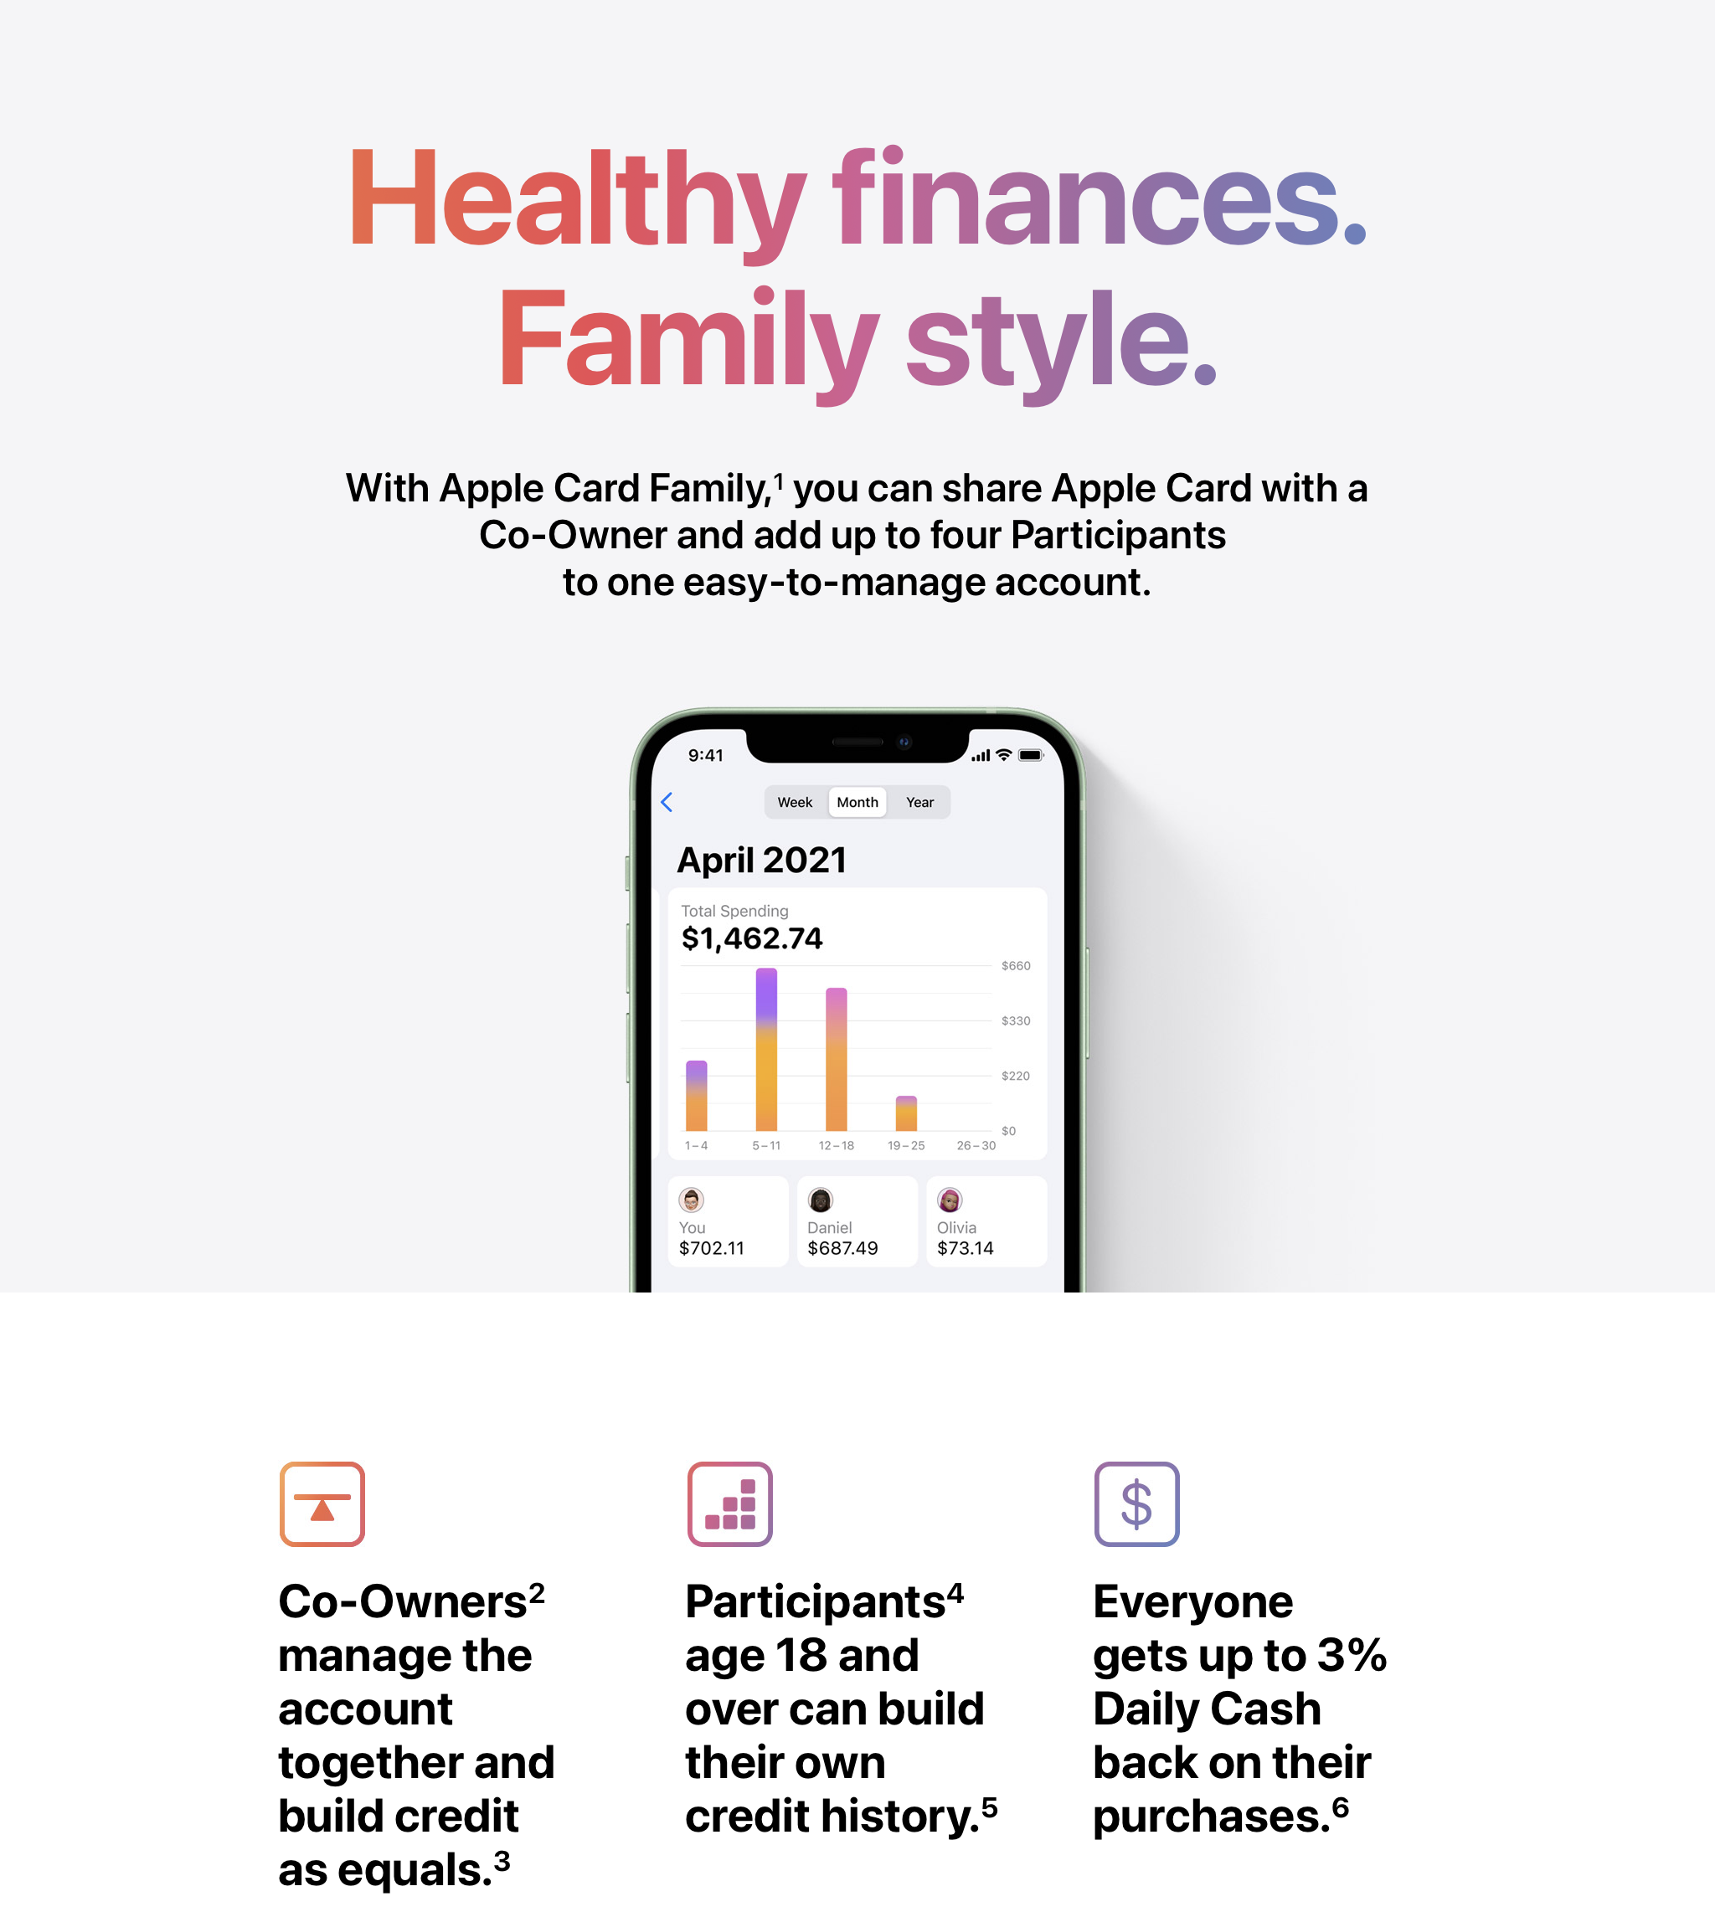

Slide 40
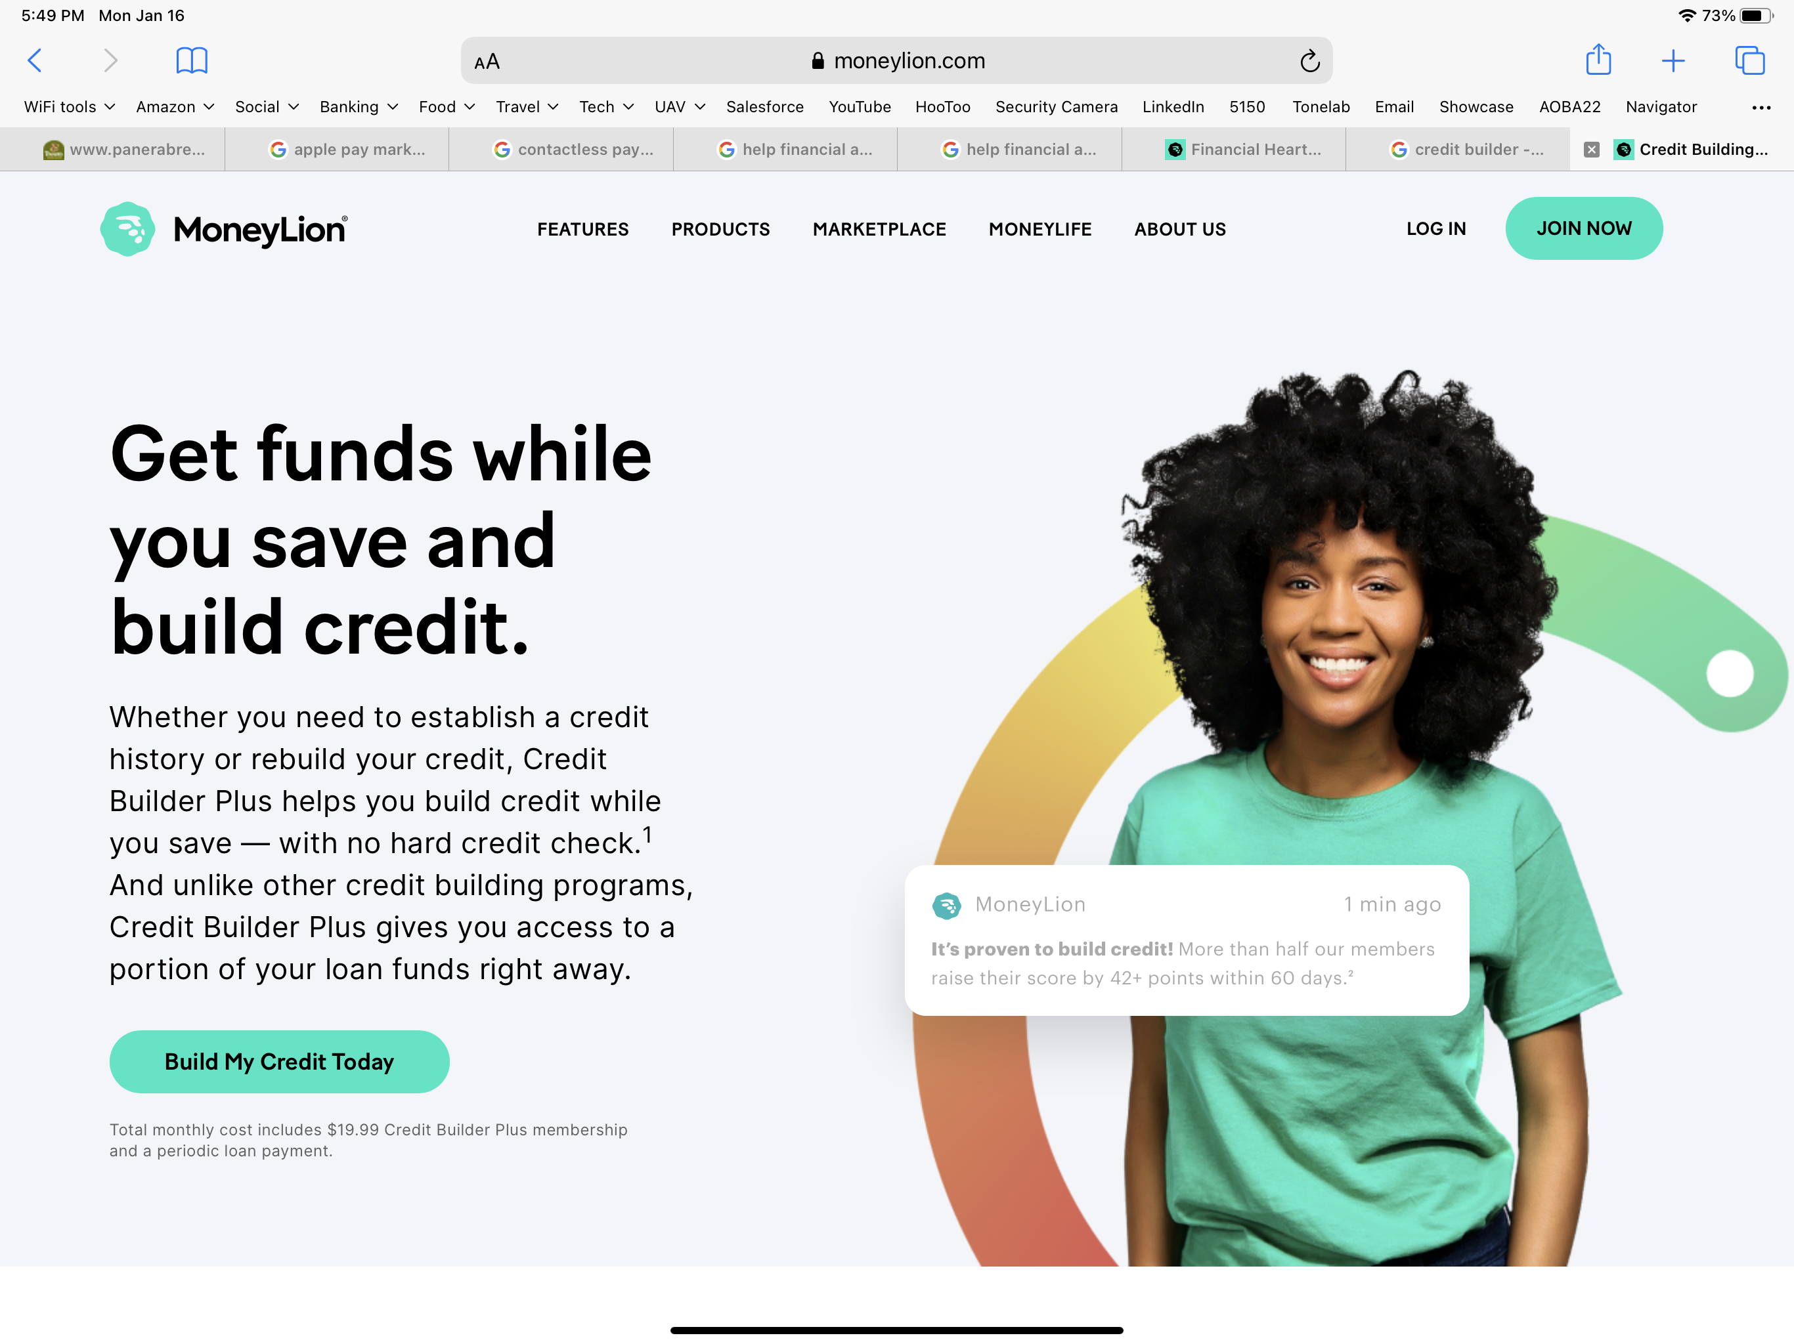
11
12
1
5
millions of users

Slide 43
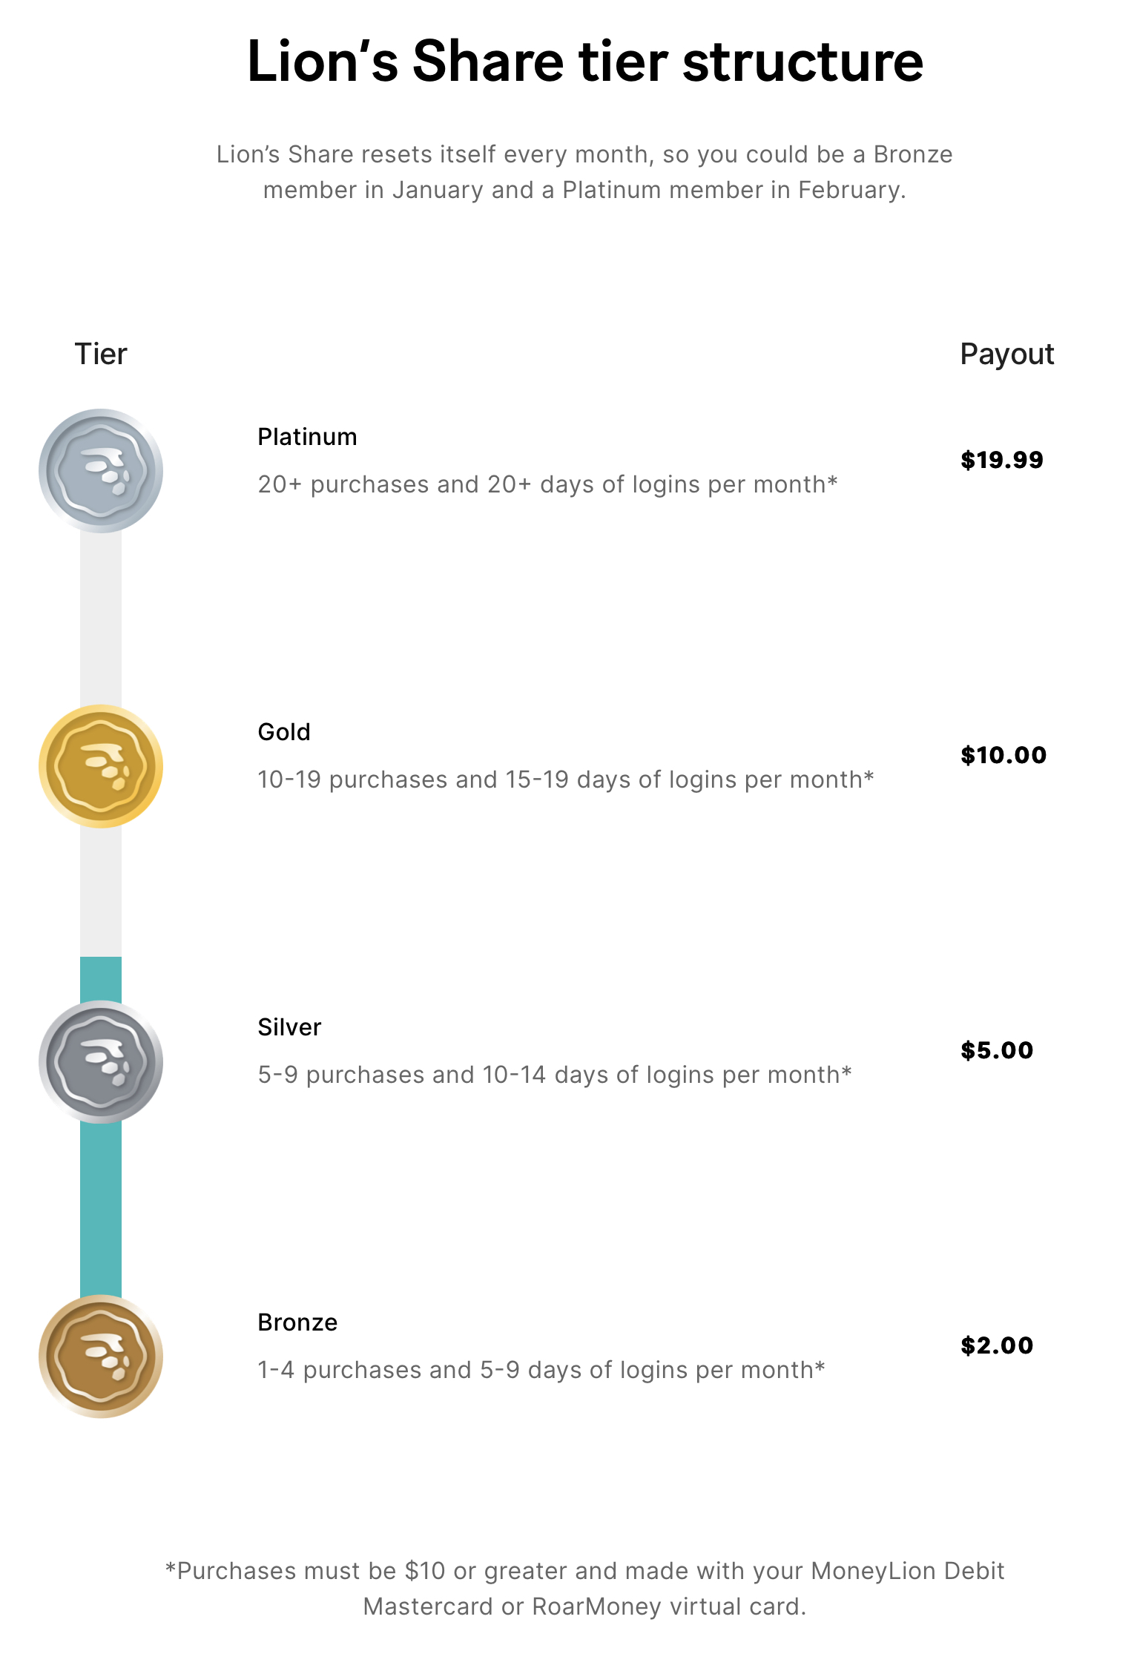

Slide 45
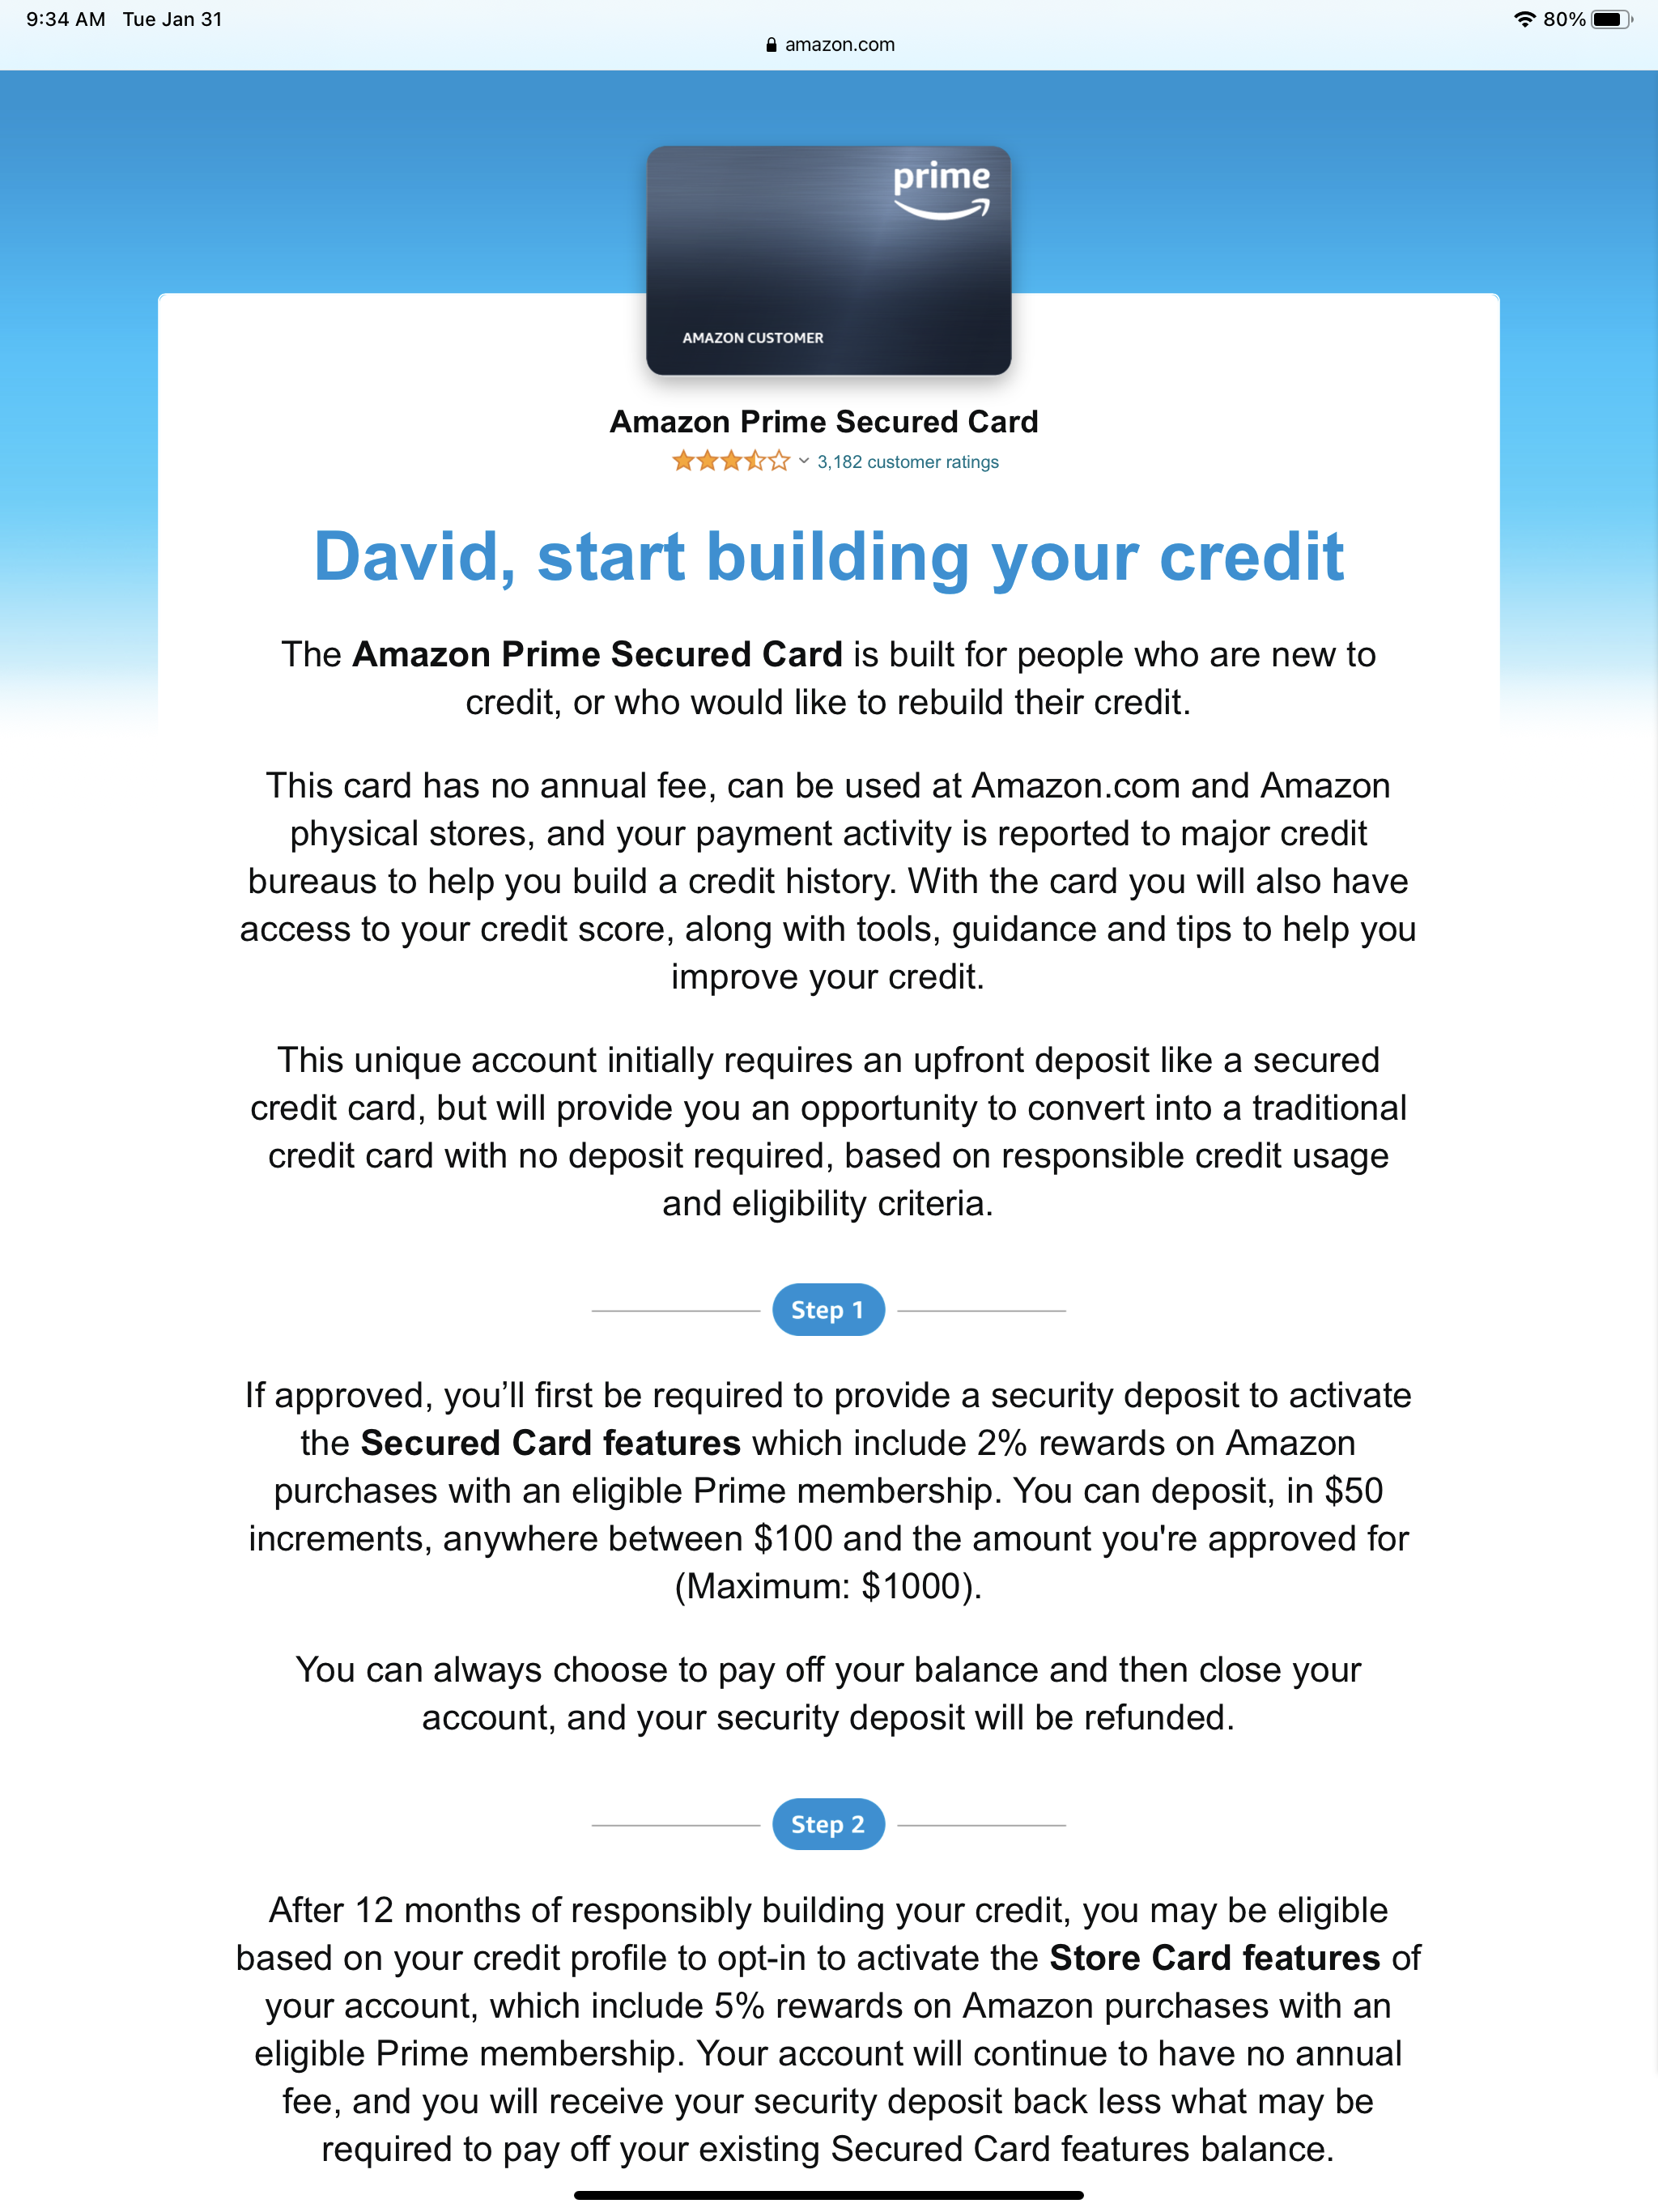

Slide 46
Graduation Plan

Slide 47
Graduation Plan

Slide 48
The very minute secured credit card consumers turn super-prime…
they get a mailer from Chase
they get a mailer from Chase
Source: Jorge Esteban, Visa, VP of Community Financial Institutions, AOBA Conference 2023

Slide 49
The very minute secured credit card consumers turn super-prime…
they get a mailer from Chase
Source: Jorge Esteban, Visa, VP of Community Financial Institutions, AOBA Conference 2023

Slide 50
Be the card above all cards…

Slide 52
90% of Americans now use digital payments
https://www.mckinsey.com/industries/financial-services/our-insights/banking-matters/consumer-trends-in-digital-payments

Slide 53
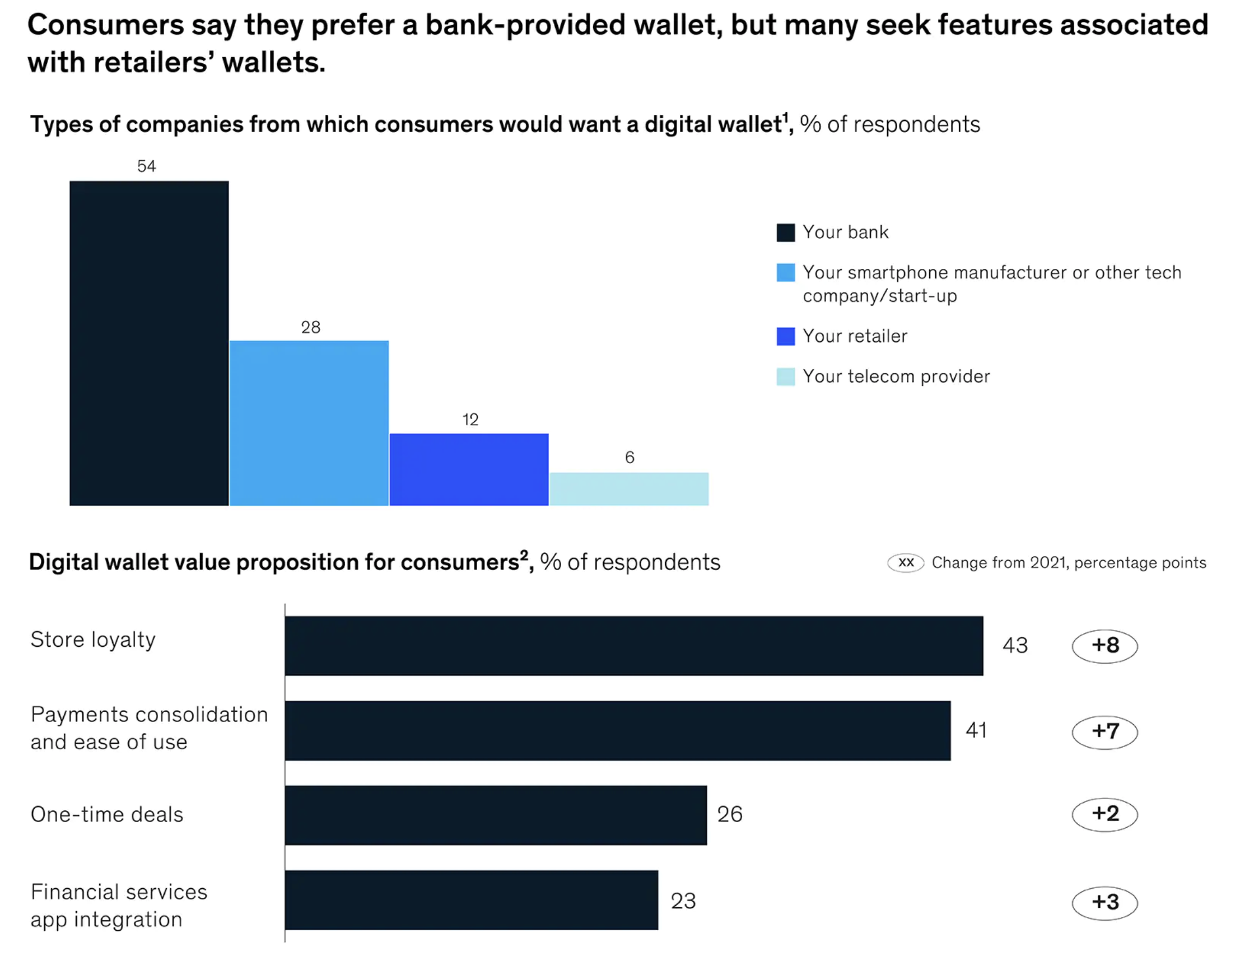
https://www.mckinsey.com/industries/financial-services/our-insights/banking-matters/consumer-trends-in-digital-payments

Slide 54
30% intend to use 3 or more digital wallets
https://www.mckinsey.com/industries/financial-services/our-insights/banking-matters/consumer-trends-in-digital-payments

Slide 55
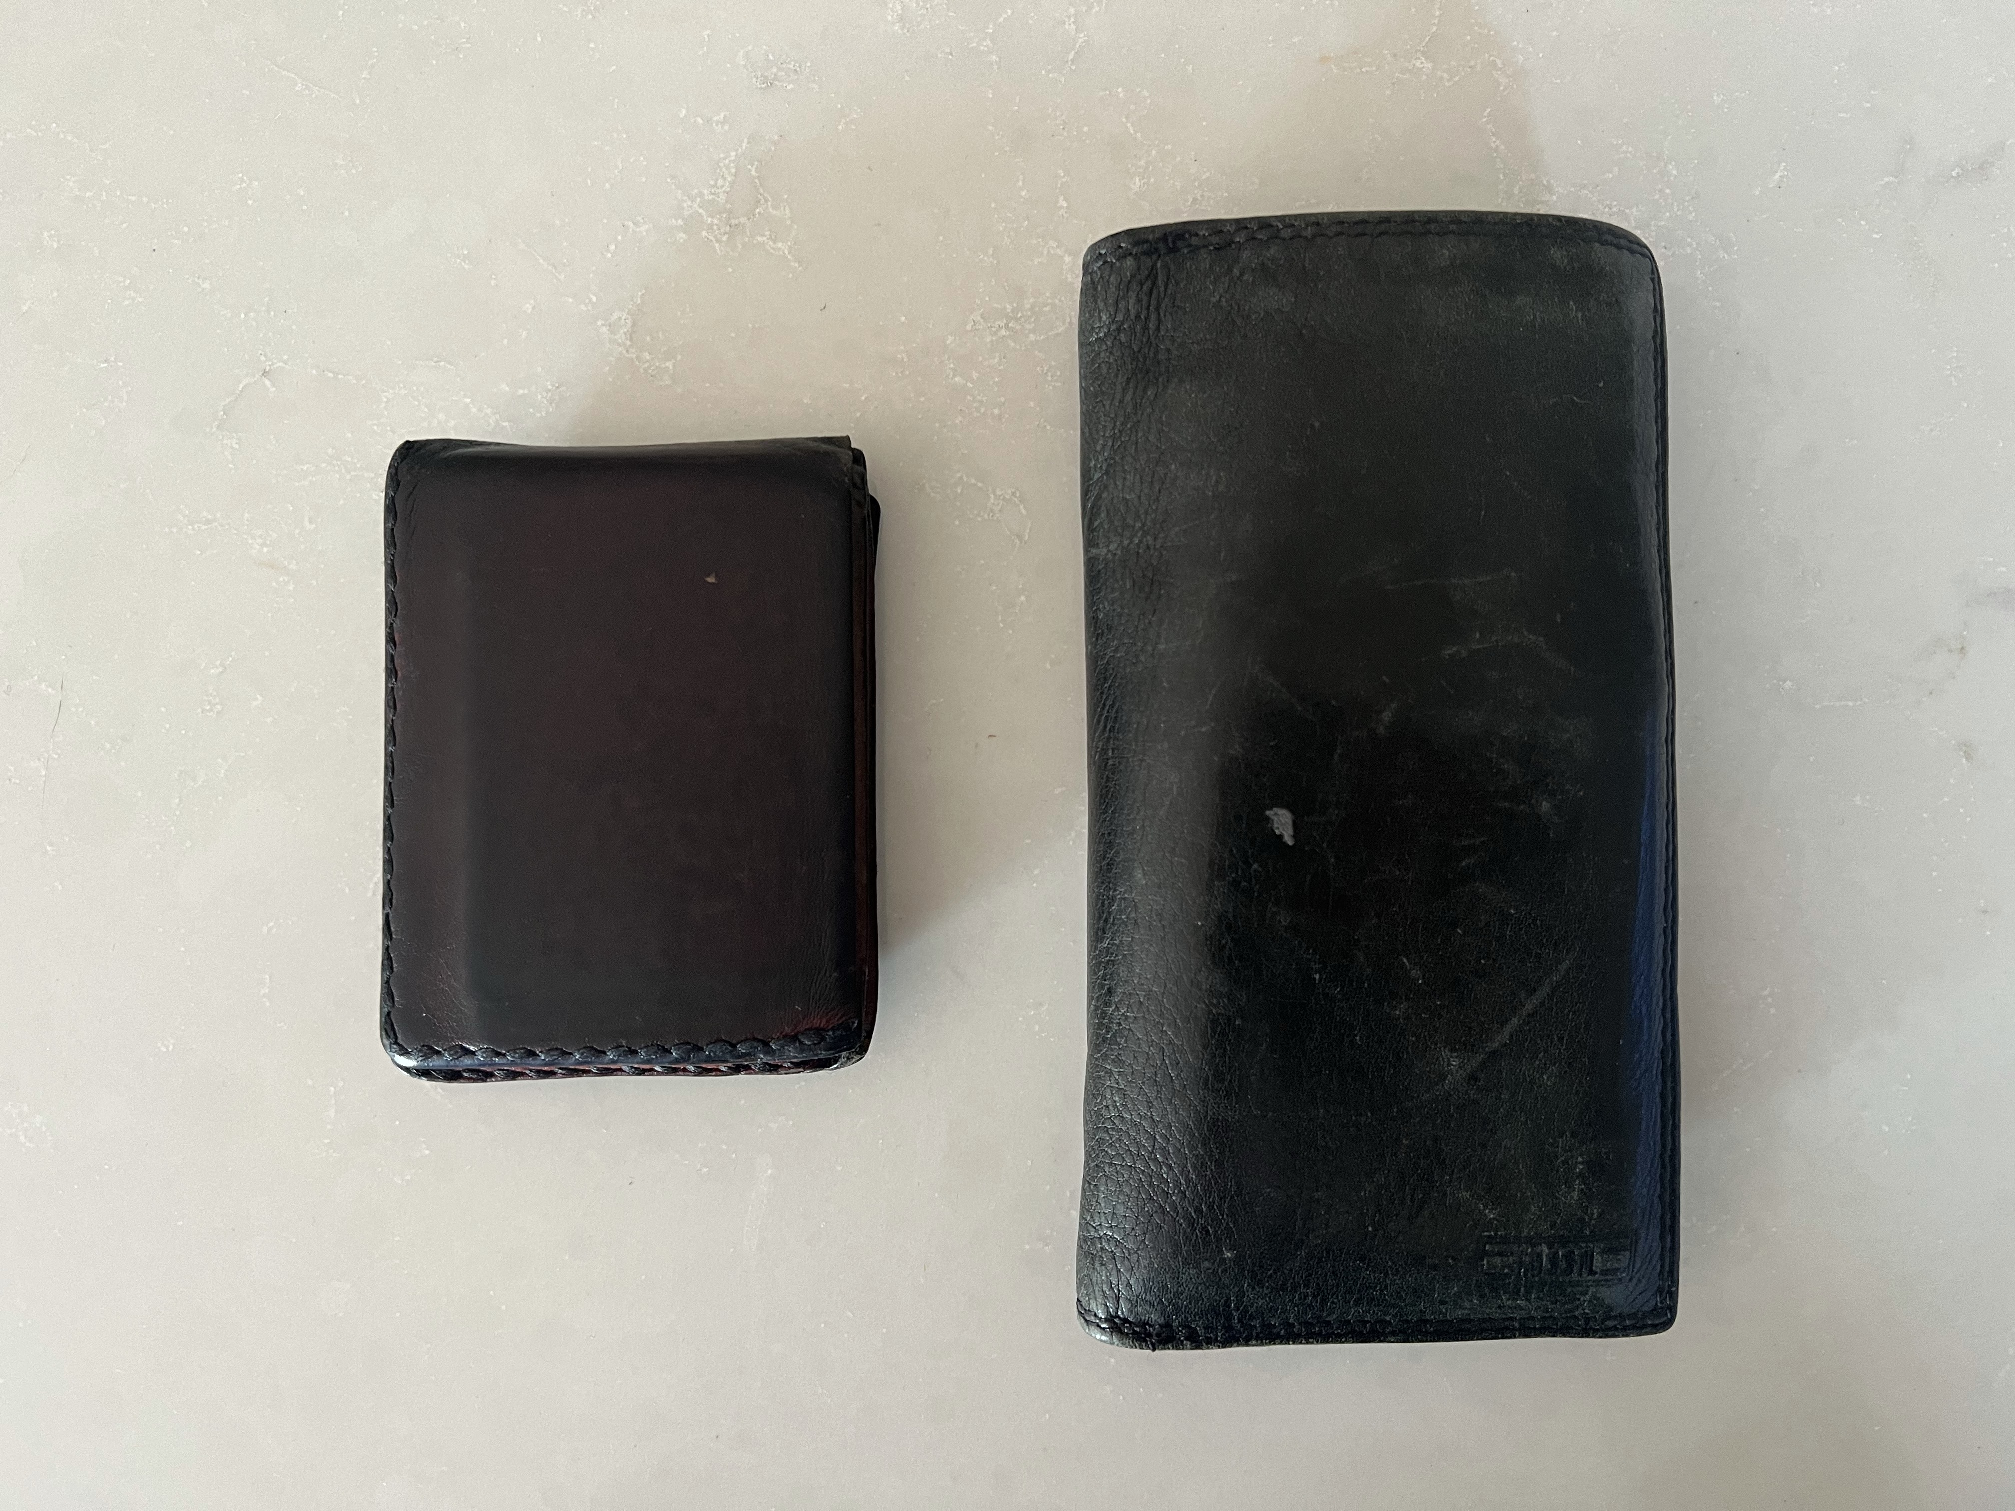

Slide 56
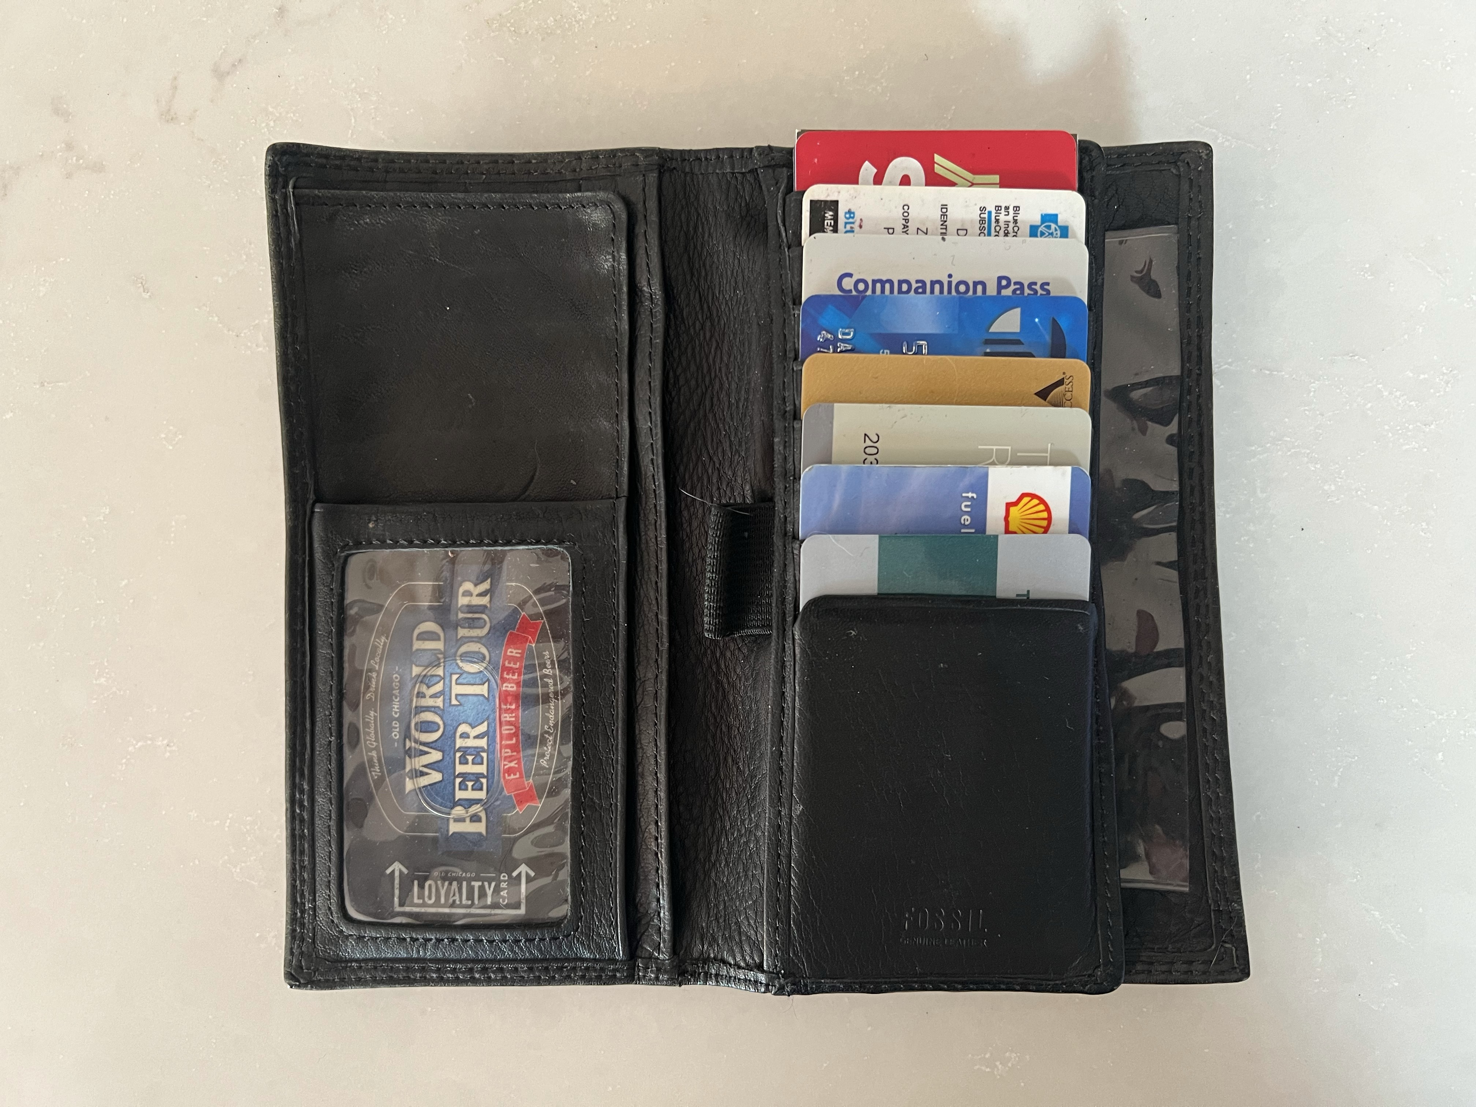
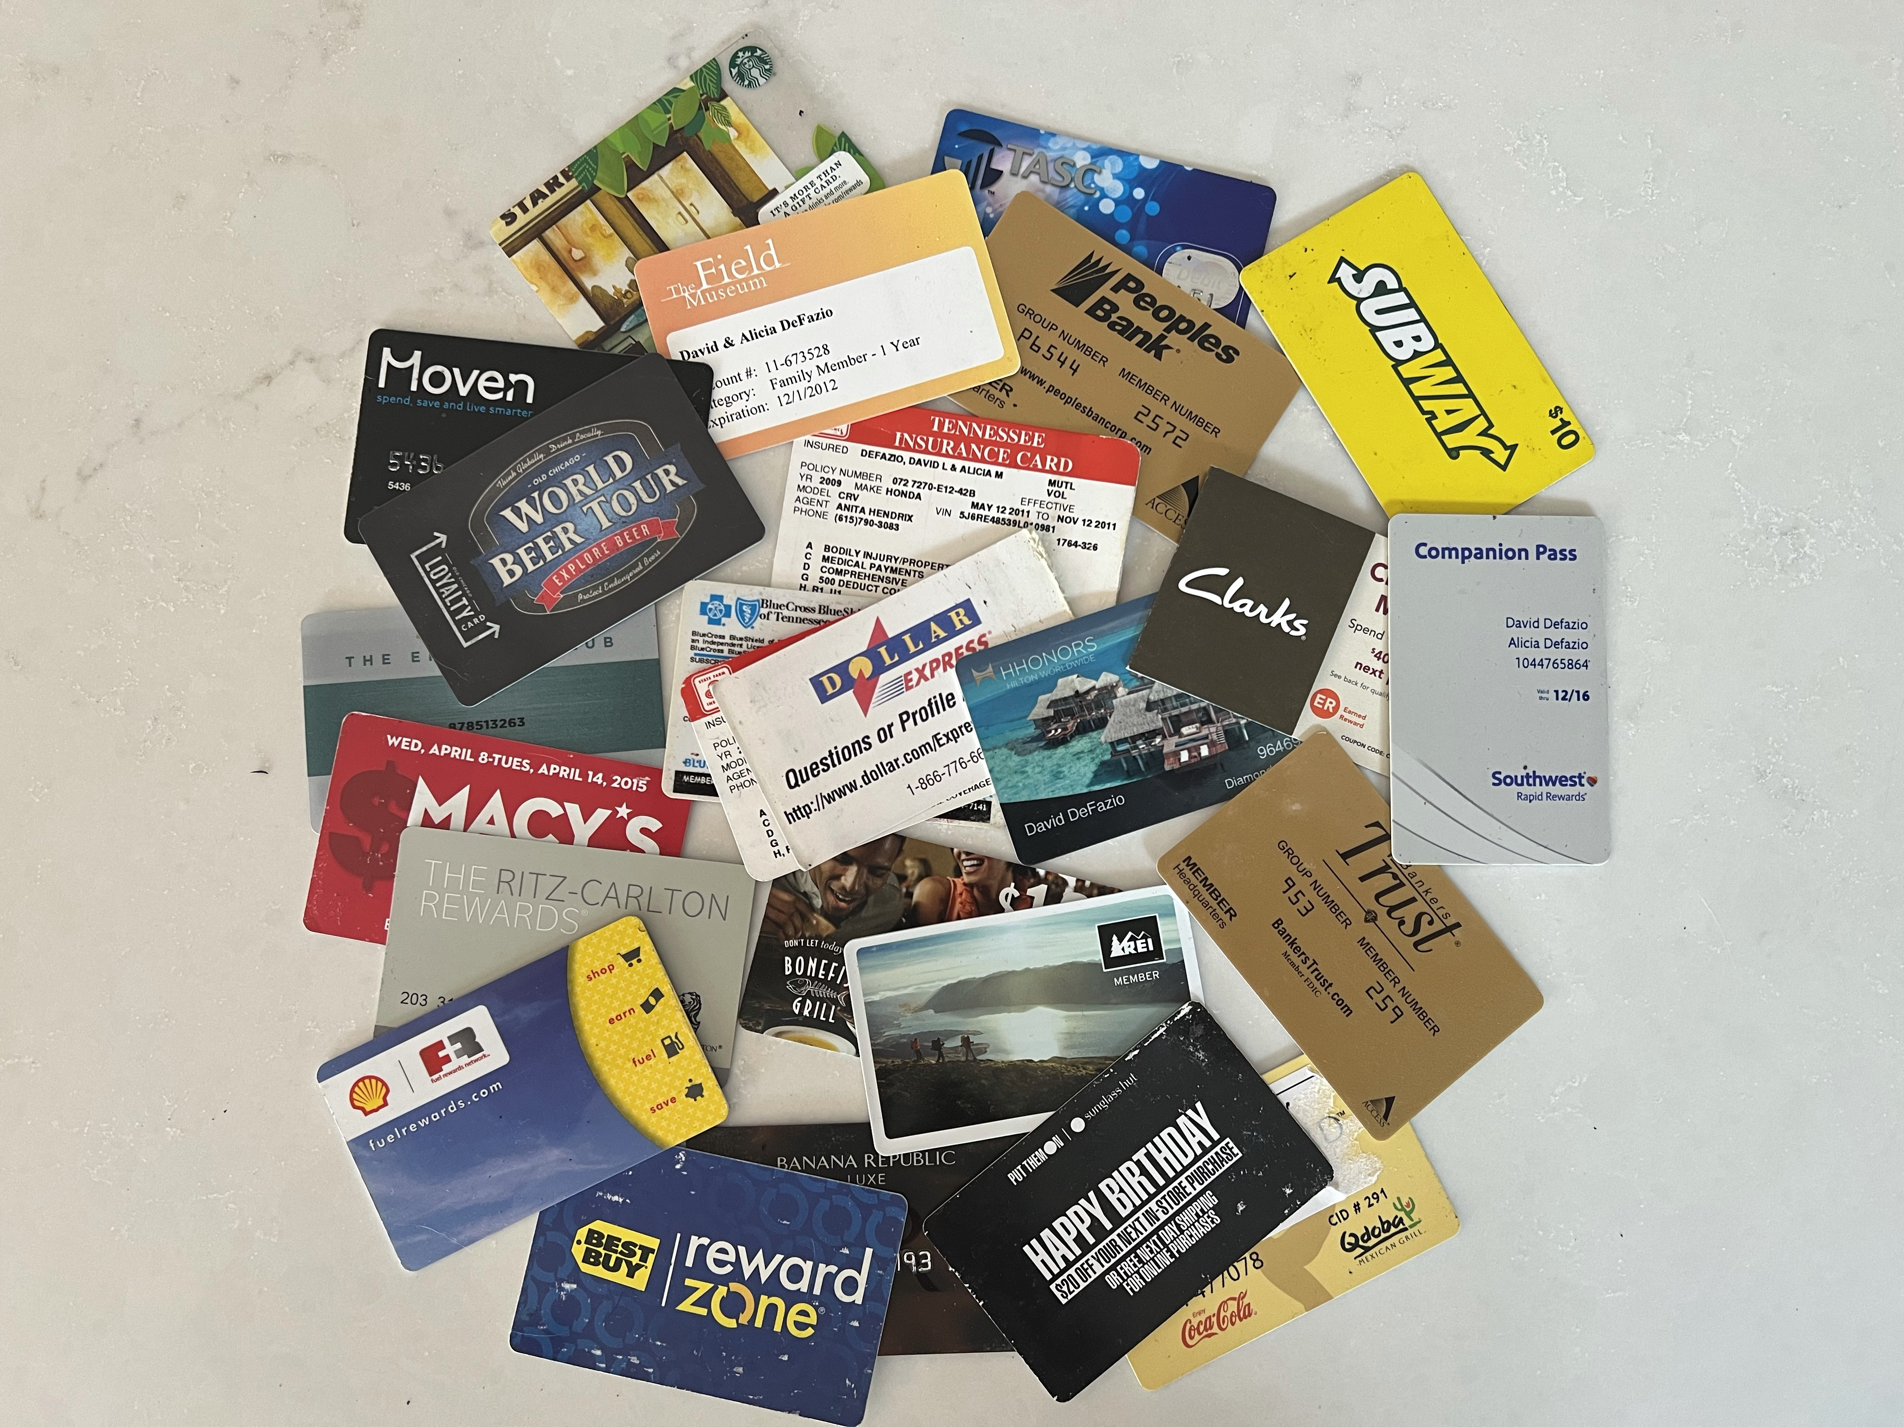

Slide 57
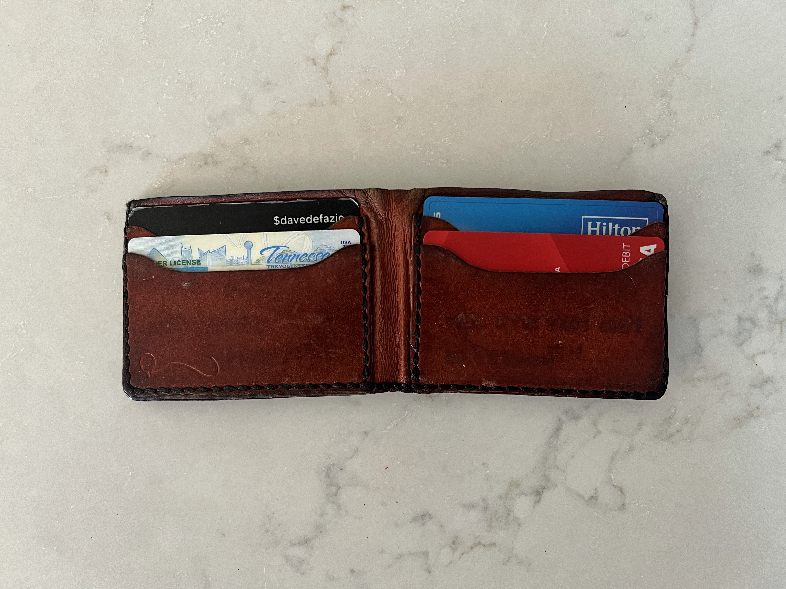

Slide 58
Every app can’t be a wallet

Slide 59
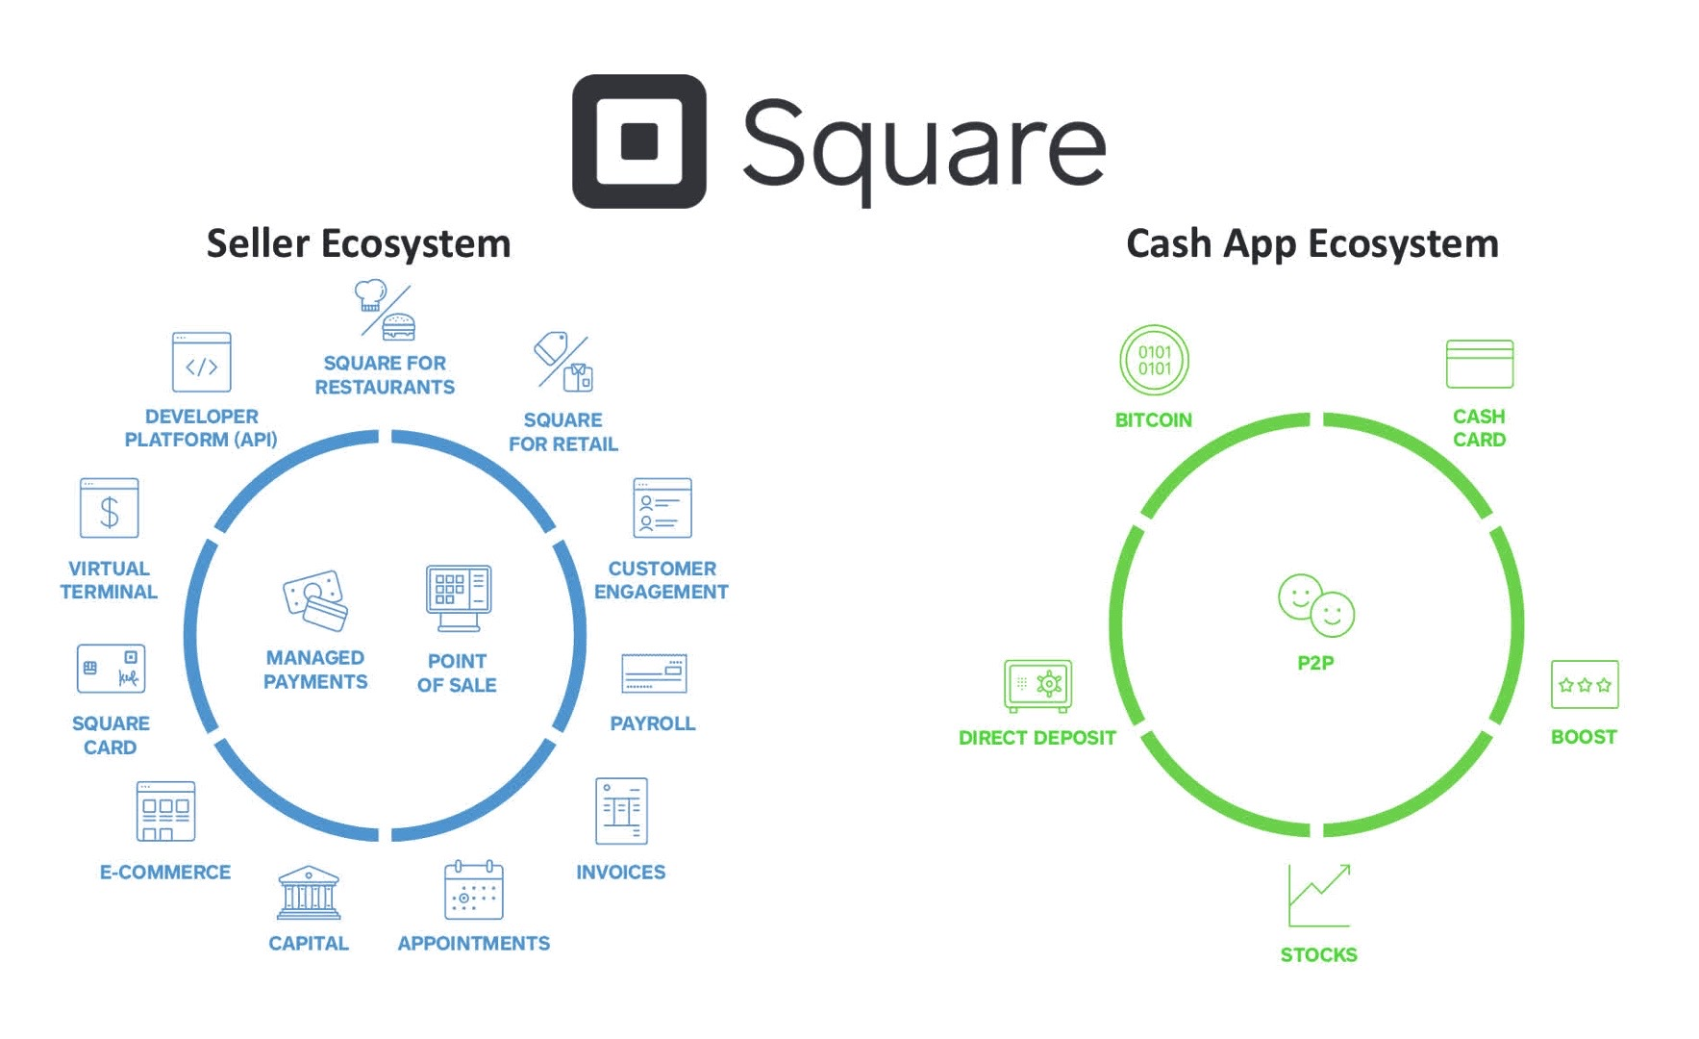

Slide 60
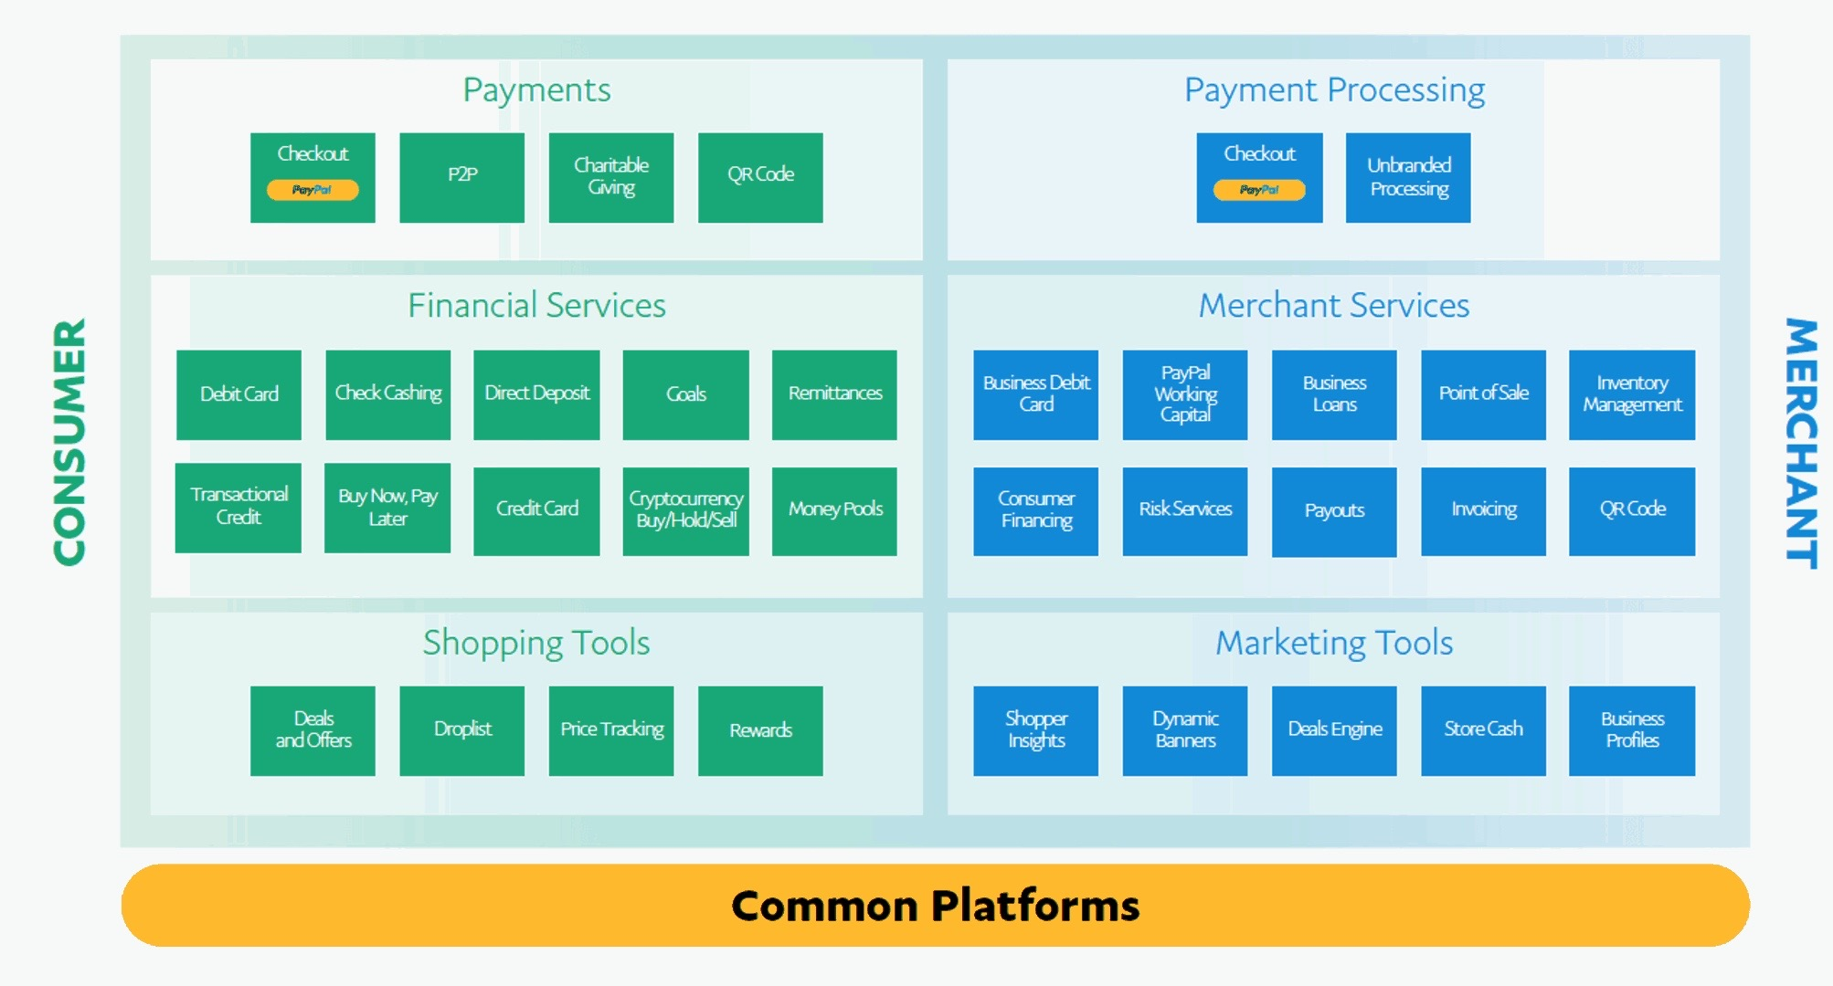

Slide 62
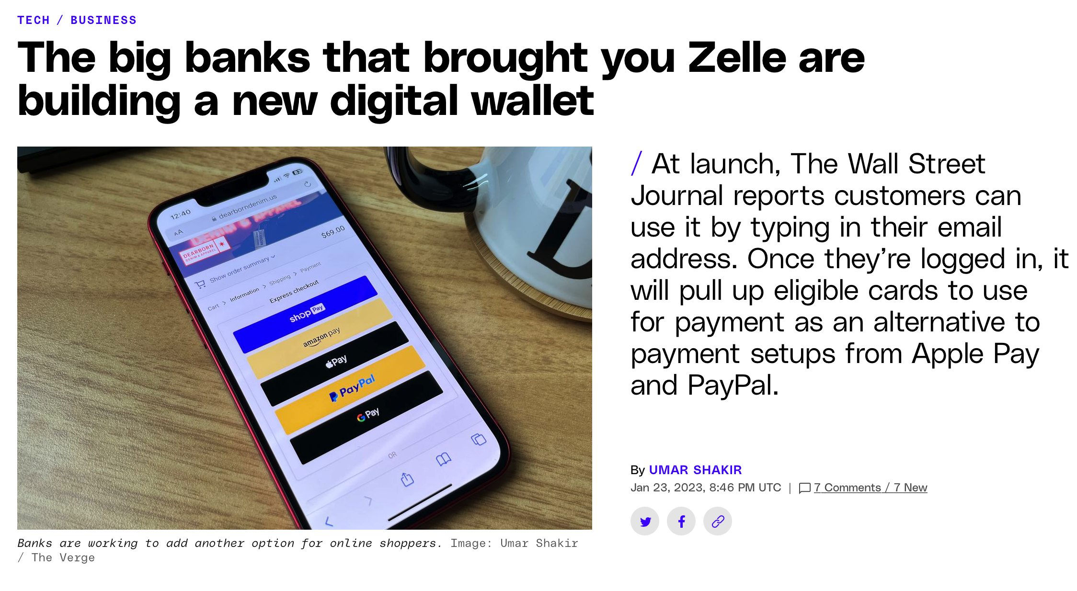

Slide 63
“Payments should be considered the 5th P of marketing”
- Ron Shevlin
Product
Price
Place
Promotion
Payments

Slide 64
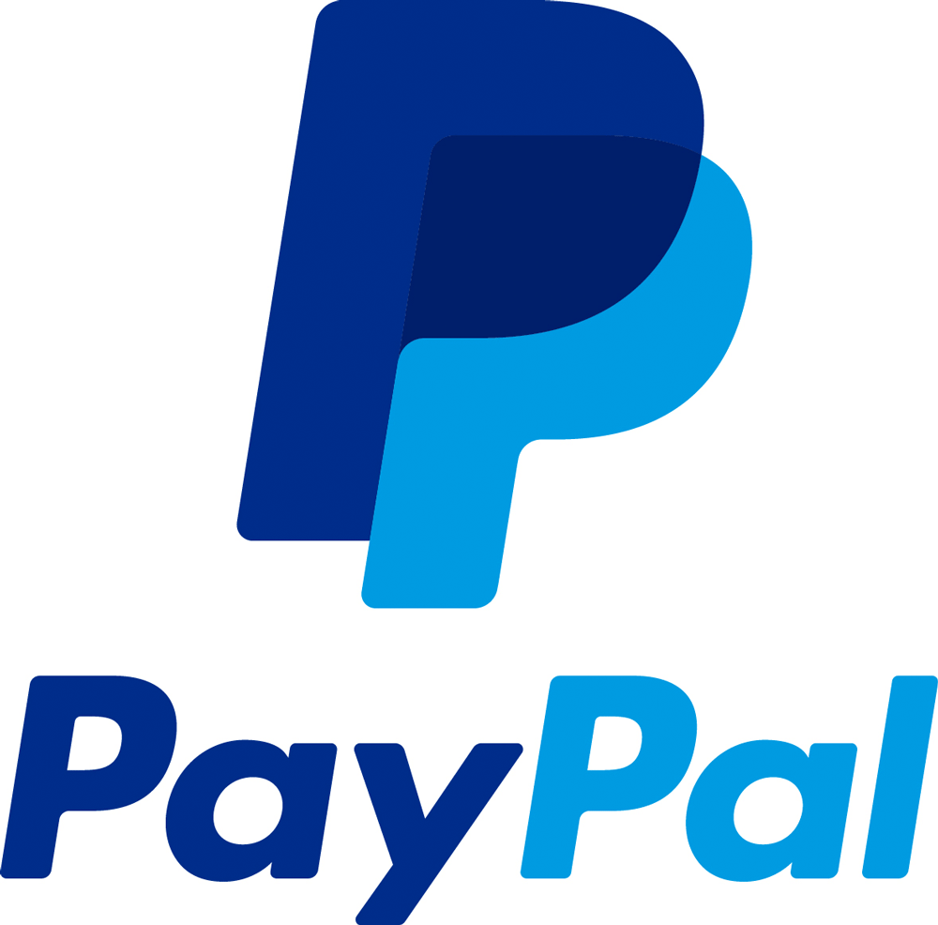
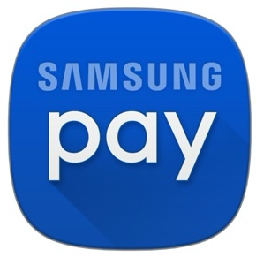
Digital Payment Segment Strategies
P2P
Retailer Apps
Device wallets
BNPL
Online/In-App
In-store purchases

Slide 65
1. Look at transactions
2. Find members that don’t have their cards connected
3. Make a promo offer
Make a purchase on AmazonPrime Day and get 5% cash back on your purchase (up to $10)!
Stranger Things Special: Switch your card on file and get Netflix free for one month!
How about an offer that’ll be music to your ears? Switch your card on file and get Spotify free for one month
Manager’s Special: Make a purchase using WalMart Pay and get cash back!

Slide 66
1. Look at transactions
2. Find members that don’t have their cards connected
3. Make a promo offer
Make a purchase on AmazonPrime Day and get 5% cash back on your purchase (up to $10)!
Stranger Things Special: Switch your card on file and get Netflix free for one month!
How about an offer that’ll be music to your ears? Switch your card on file and get Spotify free for one month
Manager’s Special: Make a purchase using WalMart Pay and get cash back!

Slide 67
Being Primary Should be your Priority …

Slide 74
Our Take on Primacy
“Primacy is how much annual revenue is generated by a householded relationship that includes a checking account.”

Slide 75
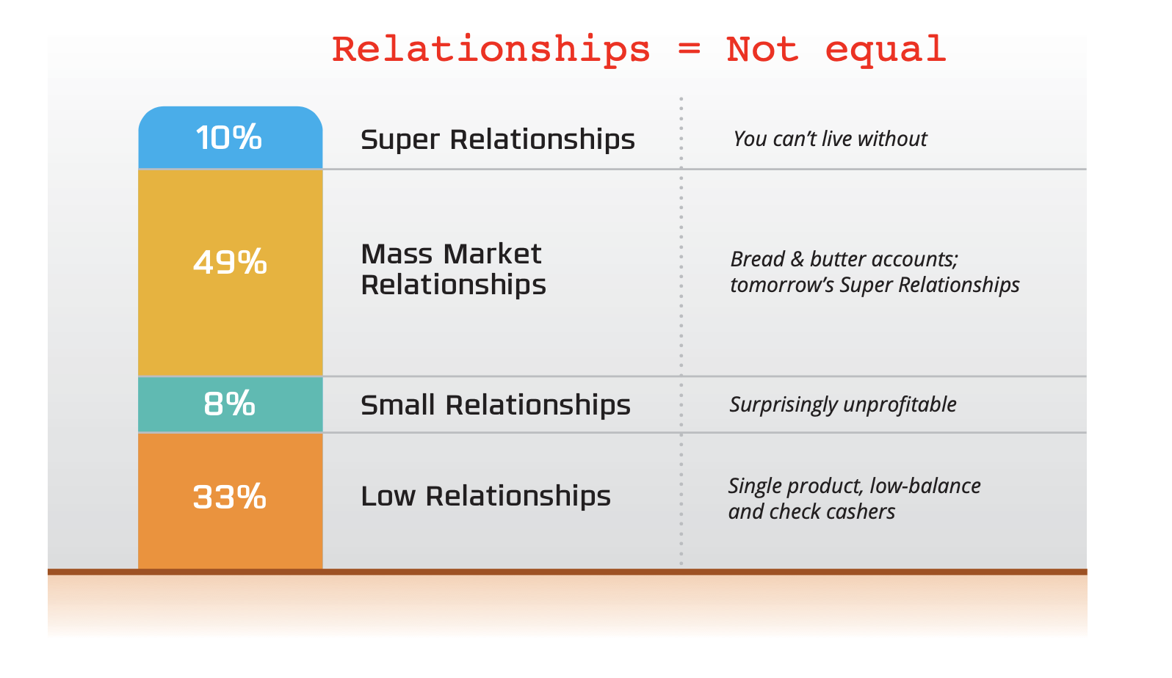

Slide 76
The Loyal
98% of your household relationship dollars come from 60% of the checking account customers.

Slide 77
The “Not-So” Loyal
40% of your checking account customers have less than 2% of your household deposits and loans.

Slide 78
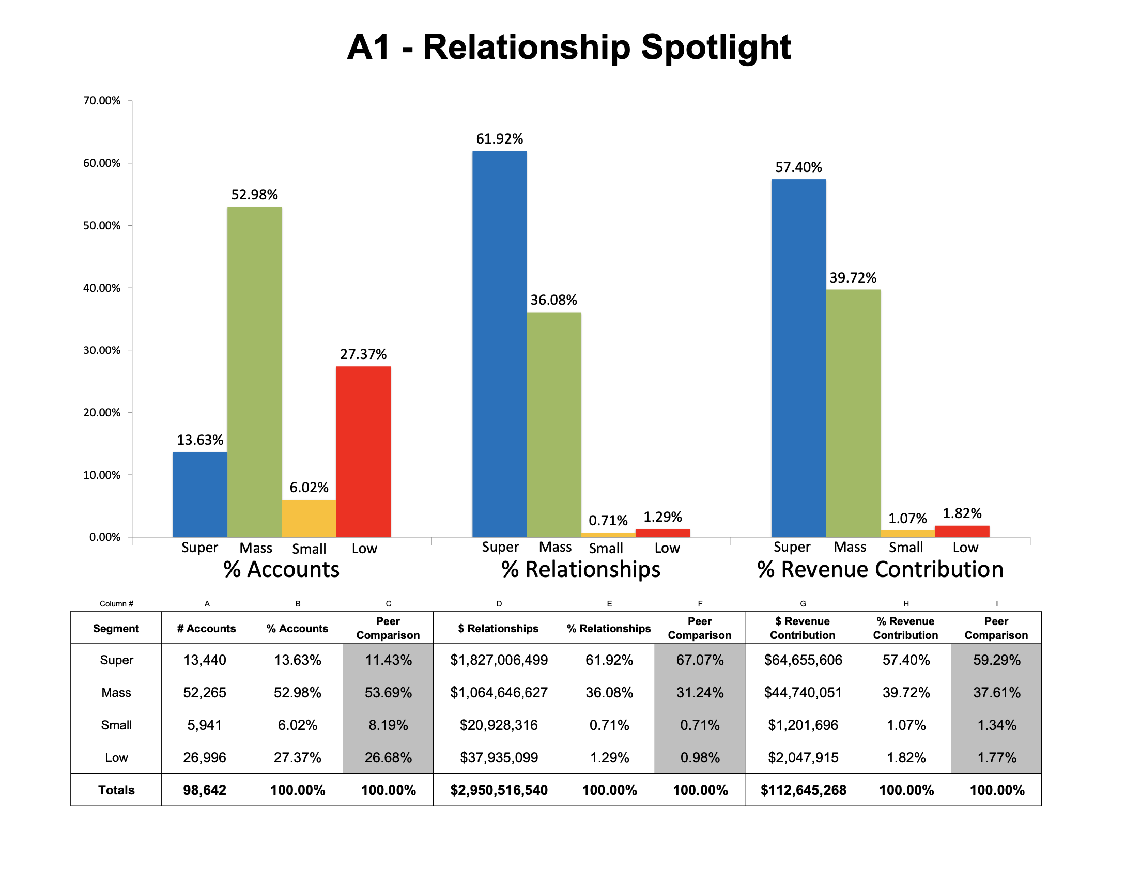

Slide 80
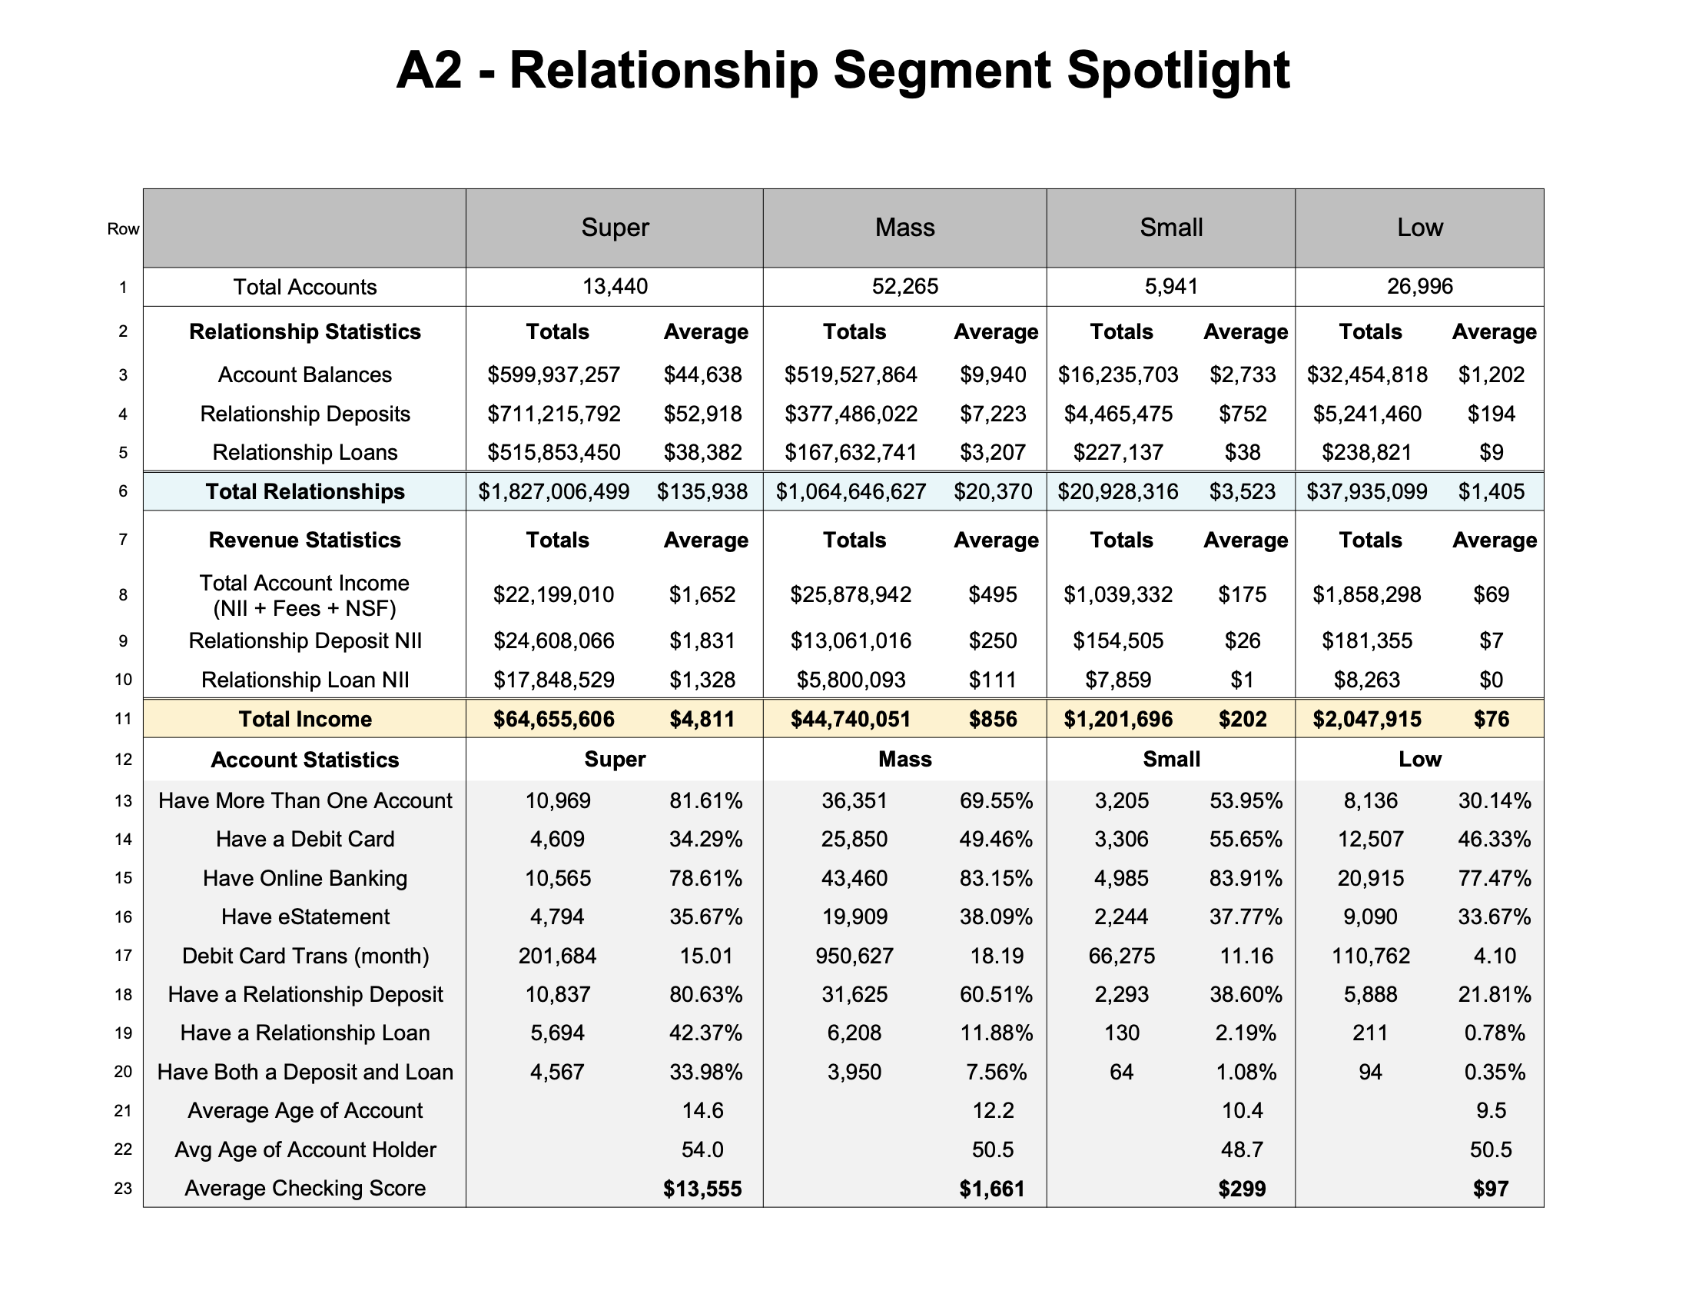

Slide 81
The Subscription Society

Slide 82
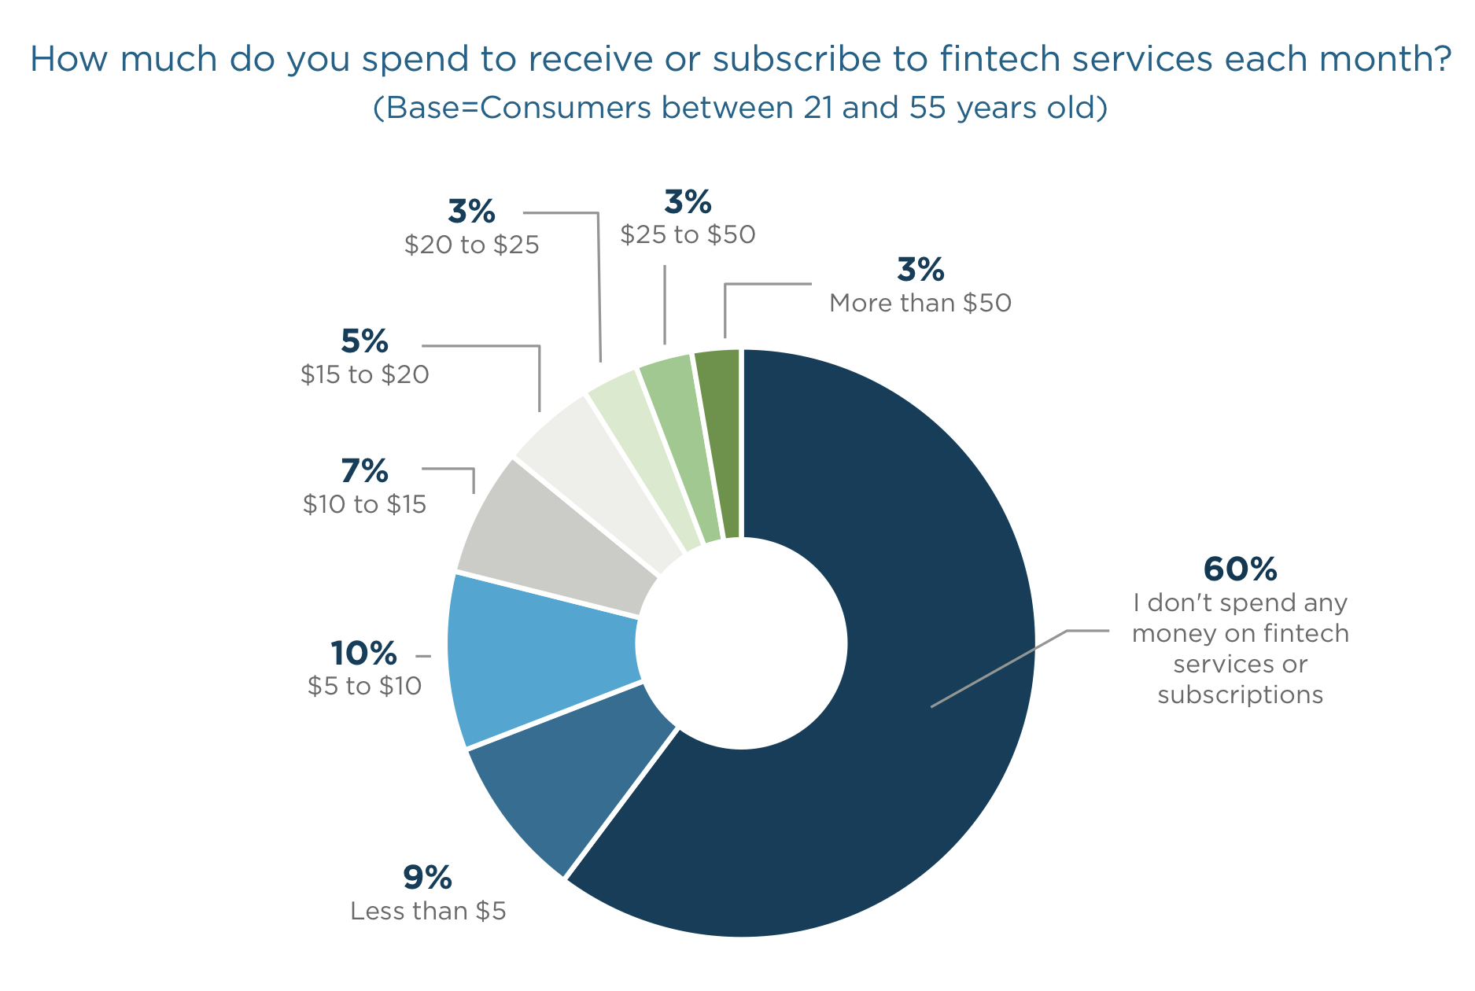
47% percent of Gen Y
44% of Gen Z
pay to access fintech services each month!

Slide 85
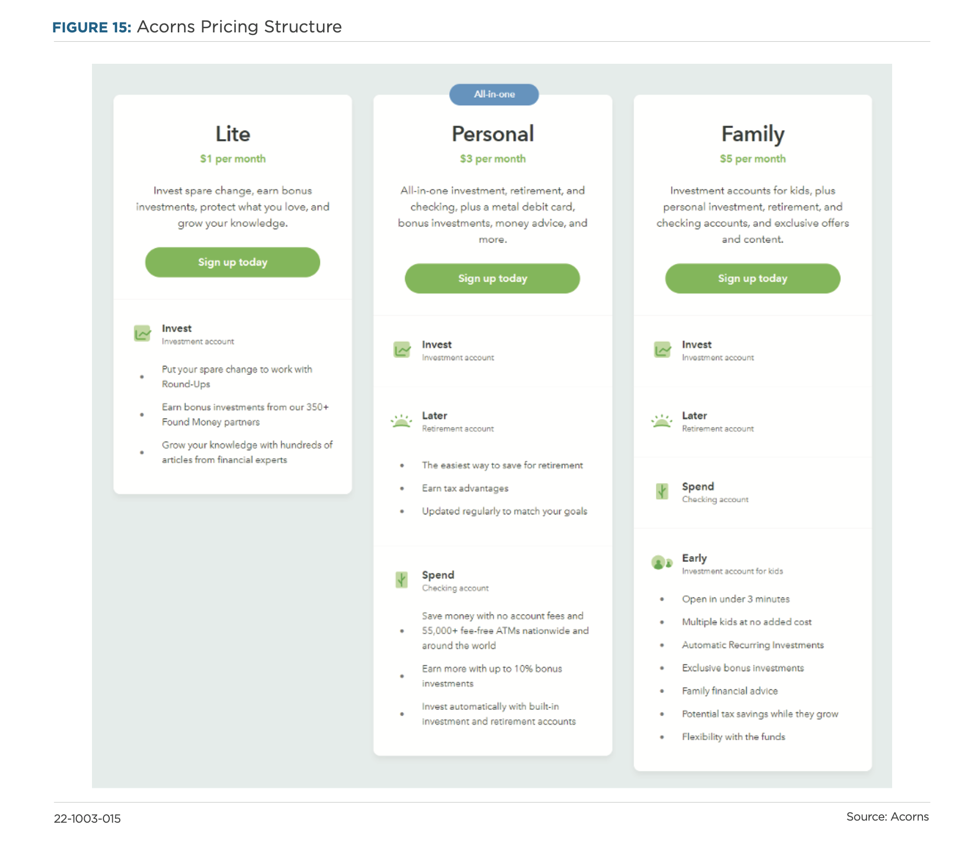

Slide 86
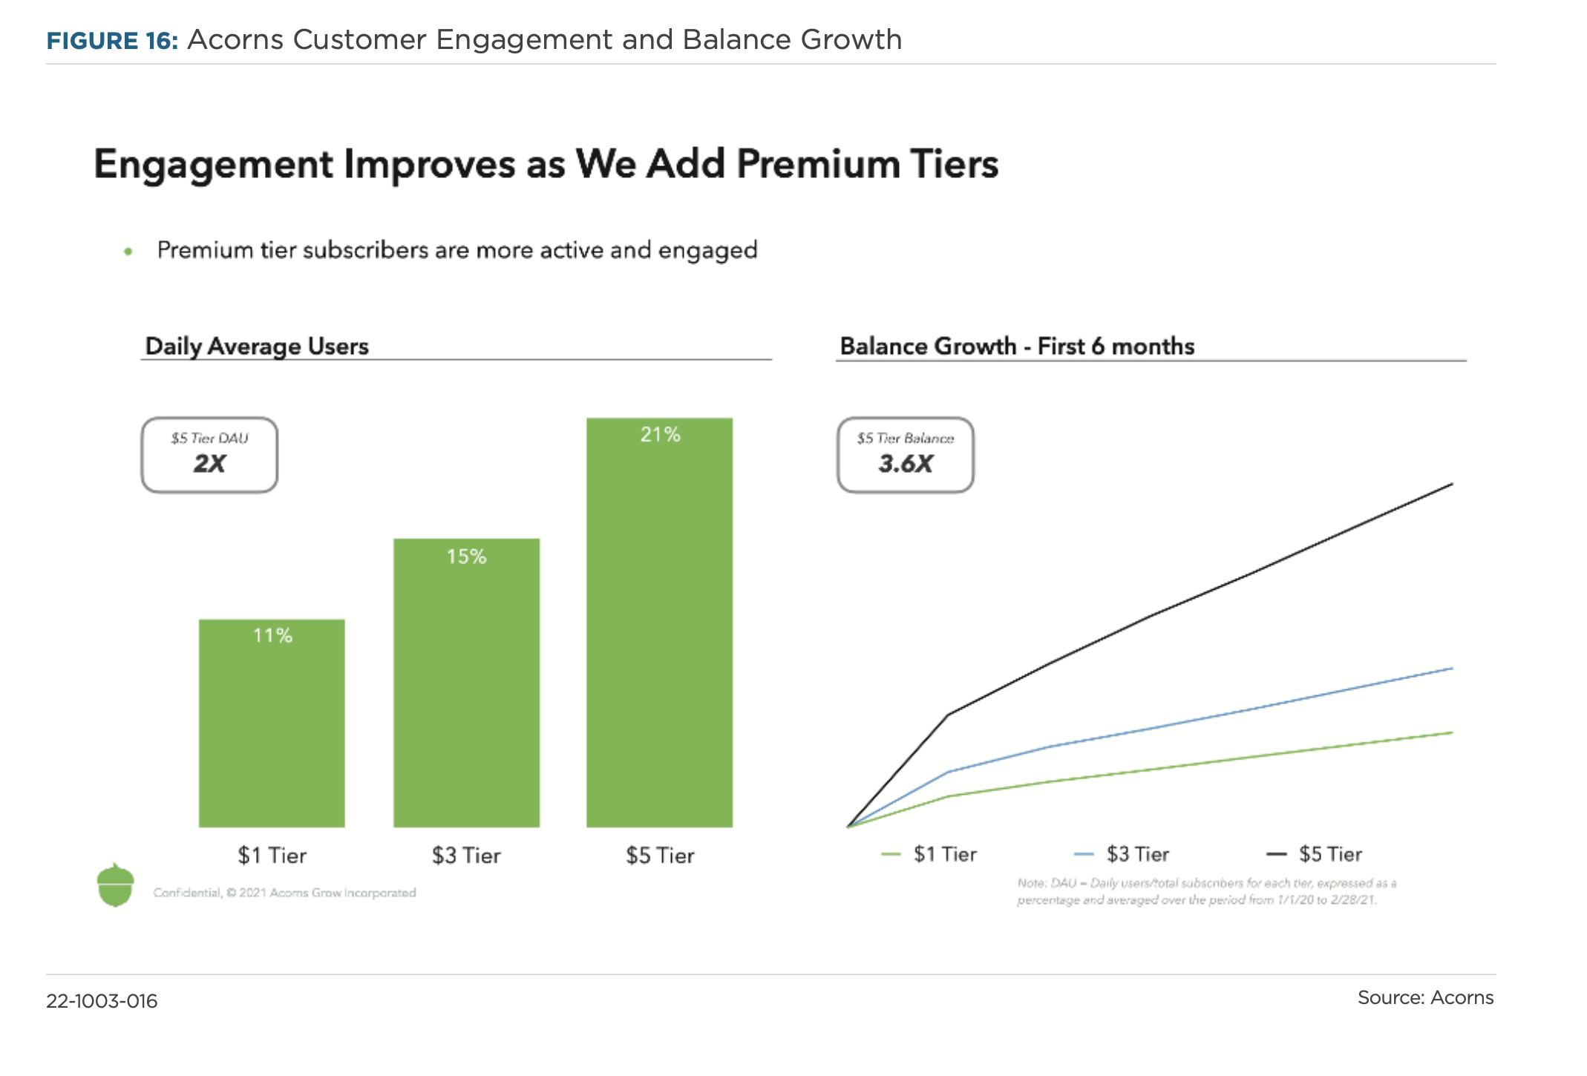

Slide 87
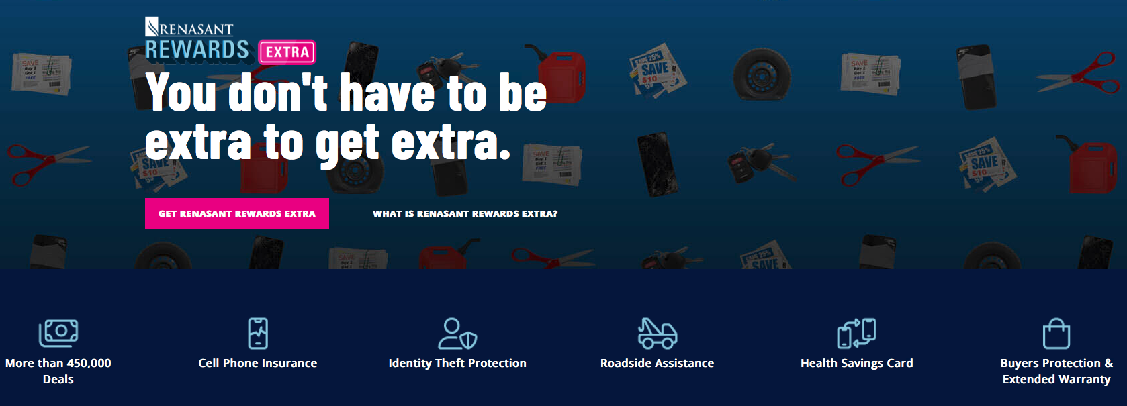
$6.50 Subscription

Slide 89
Adam Thompson
Director of Sales
adam.thompson@strategycorps.com
615-519-7907
linkedin.com/in/athompson3233
Notes:
Introductions:
create some small talk to establish a good vibe for the interaction
I appreciate you taking this time to visit with me today, and I’m excited to show you some of the things that we do for our bank clients
Why don’t we start with some brief introductions?
I’ll start us off. I’m Dave DeFazio, and I’ve been with StrategyCorps since we started…
(be brief and focus on experiences that are relevant to retail banking and products)
Can you introduce yourself and tell me how you landed in your chair there at the bank?

